Slide 1
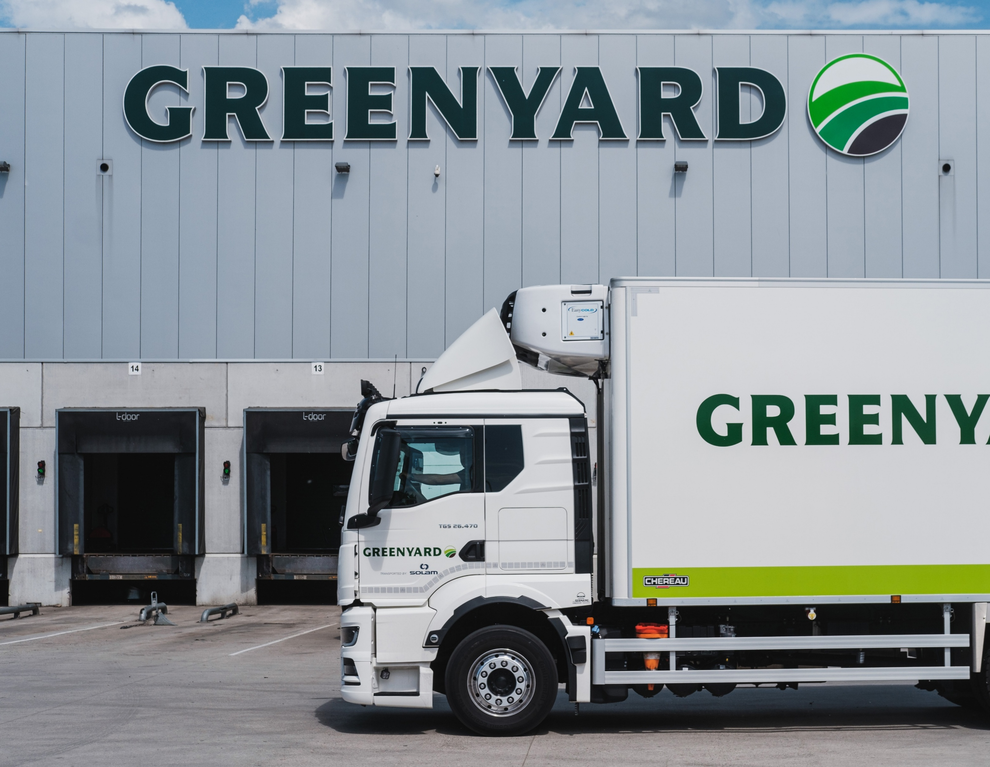
Full Year Results 24/25

Slide 2
Disclaimer.
Today’s presentation includes forward-looking statements that reflect Greenyard NV’s current views with respect to future events, financial performance, expected synergies and industry conditions. These statements are not statements of historical fact. The words “believe”, “may”, “could”, “will”, “should”, “would”, “anticipate”, “estimate”, “expect”, “intend”, “objective”, “seek”, “strive”, “target” or similar words, or the negative of these words, identify forward-looking statements. The inclusion of this forward-looking information should not be regarded as a representation by us or any other person that the future plans, estimates or expectations contemplated by us will be achieved.
These forward-looking statements are subject to various risks and uncertainties that may cause actual results to differ materially from those expressed or implied statements. Greenyard NV has provided additional information in its recent reports concerning certain factors, risks and uncertainties that could cuase actual results to differ materially from those contained in this presentation. These factors include, but are not limited to weather conditions, natural disasters, crop disease, pests, other natural conditions and geopolitical risks, which may affect prices and the demand for our products, and our ability to mitigate such risks, our ability to compete and innovate against our competitors, and increases in commodity or raw product costs that could adversely affect our operating results.
Although we believe that the expectations reflected in this presentation are reasonable, we cannot guarantee future results, levels of activity, performance or achievements. Except as otherwise noted, these forward-looking statements speak only as of the date on which such statements are made, and we do not undertake any obligation to update any forward-looking statement to reflect events or circumstances after the date on which such statement is made except as required by law. If one or more risks or uncertainties materialize, or if our underlying assumptions prove to be incorect, our actual results may vary materially from what we may have expressed or implied by these forward-looking statements. We caution that you should not place undue reliance on any of our forward-looking statements. Greenyard NV disclaims any liability for statements made or published by third parties and does not undertake to correct incorrect data, information, conclusions or opinions published by third parties in relation to this or any other presentation or press release issued by Greenyard NV.
In this presentation, we use certain alternative performance measures (“APM”) to evaluate current and past performance and prospects for the future to supplement our IFRS financial information presented in accordance with IFRS. These APMs are important factors in assessing our operating results and profitability because we believe they assist investors and analysts in comparing our operating performance across reporting periods on a consistent basis by excluding items that we do not believe are indicative of our core operating performance. These APMs have limitations as analytical tools, and you should not consider them in isolation or as a substitute for analysis of our operating results, cash flows or any other measure prescribed by IFRS. Our presentation of APMs should not be construed as an interference that our future results will be unaffected by any of the adjusted items, or that any projections and estimates will be realised in their entirety or at all. A reconciliation of APMs to the most directly comparable IFRS measures is contained in appendix to this presentation.
All definitions are available in the Glossary of the Annual Report.

Slide 3
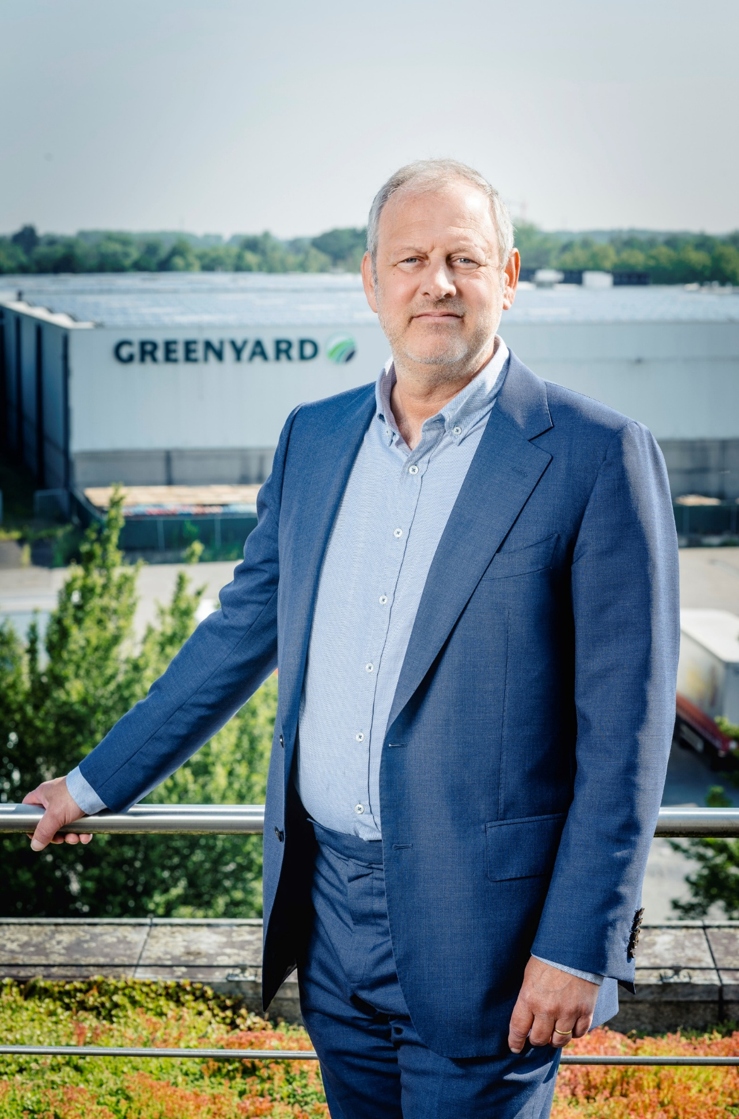
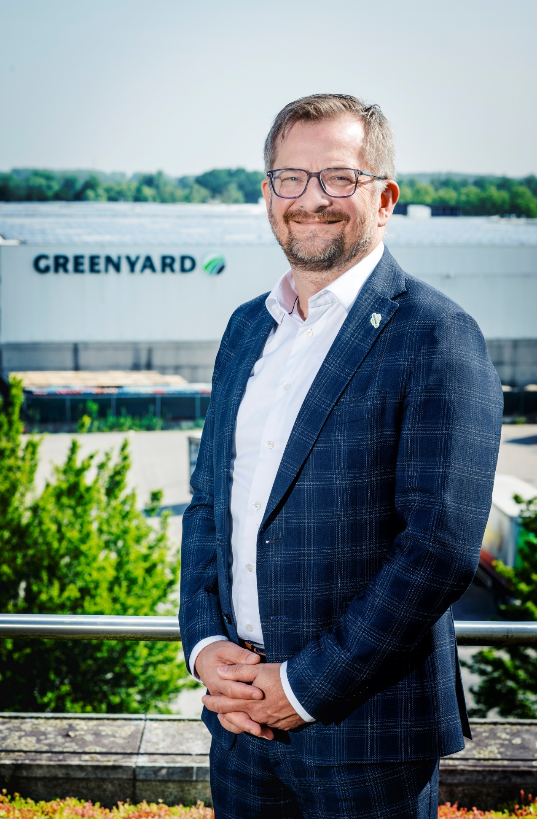
Today’s presenters.
Greenyard Group
Francis Kint
Chief Executive Officer
Nicolas De Clercq
Chief Financial Officer

Slide 4
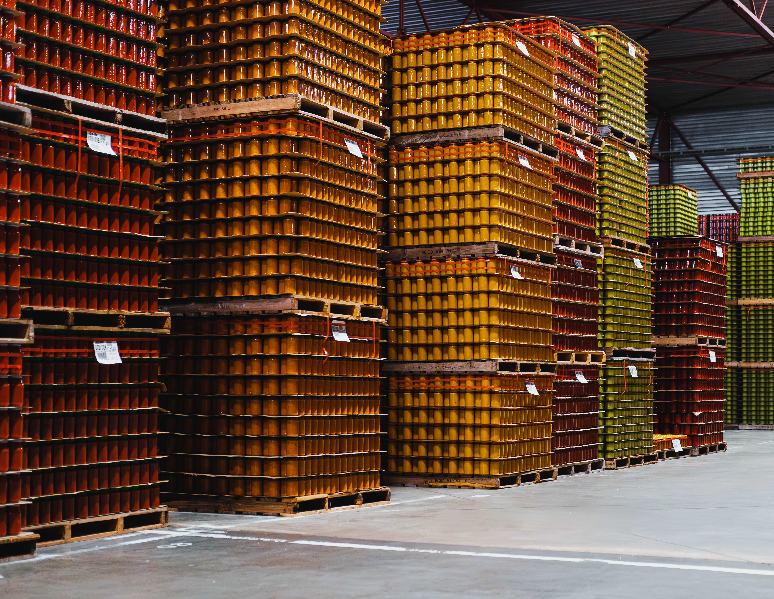
All about Greenyard
Review
Accounting Year 2024 / 2025

Slide 5
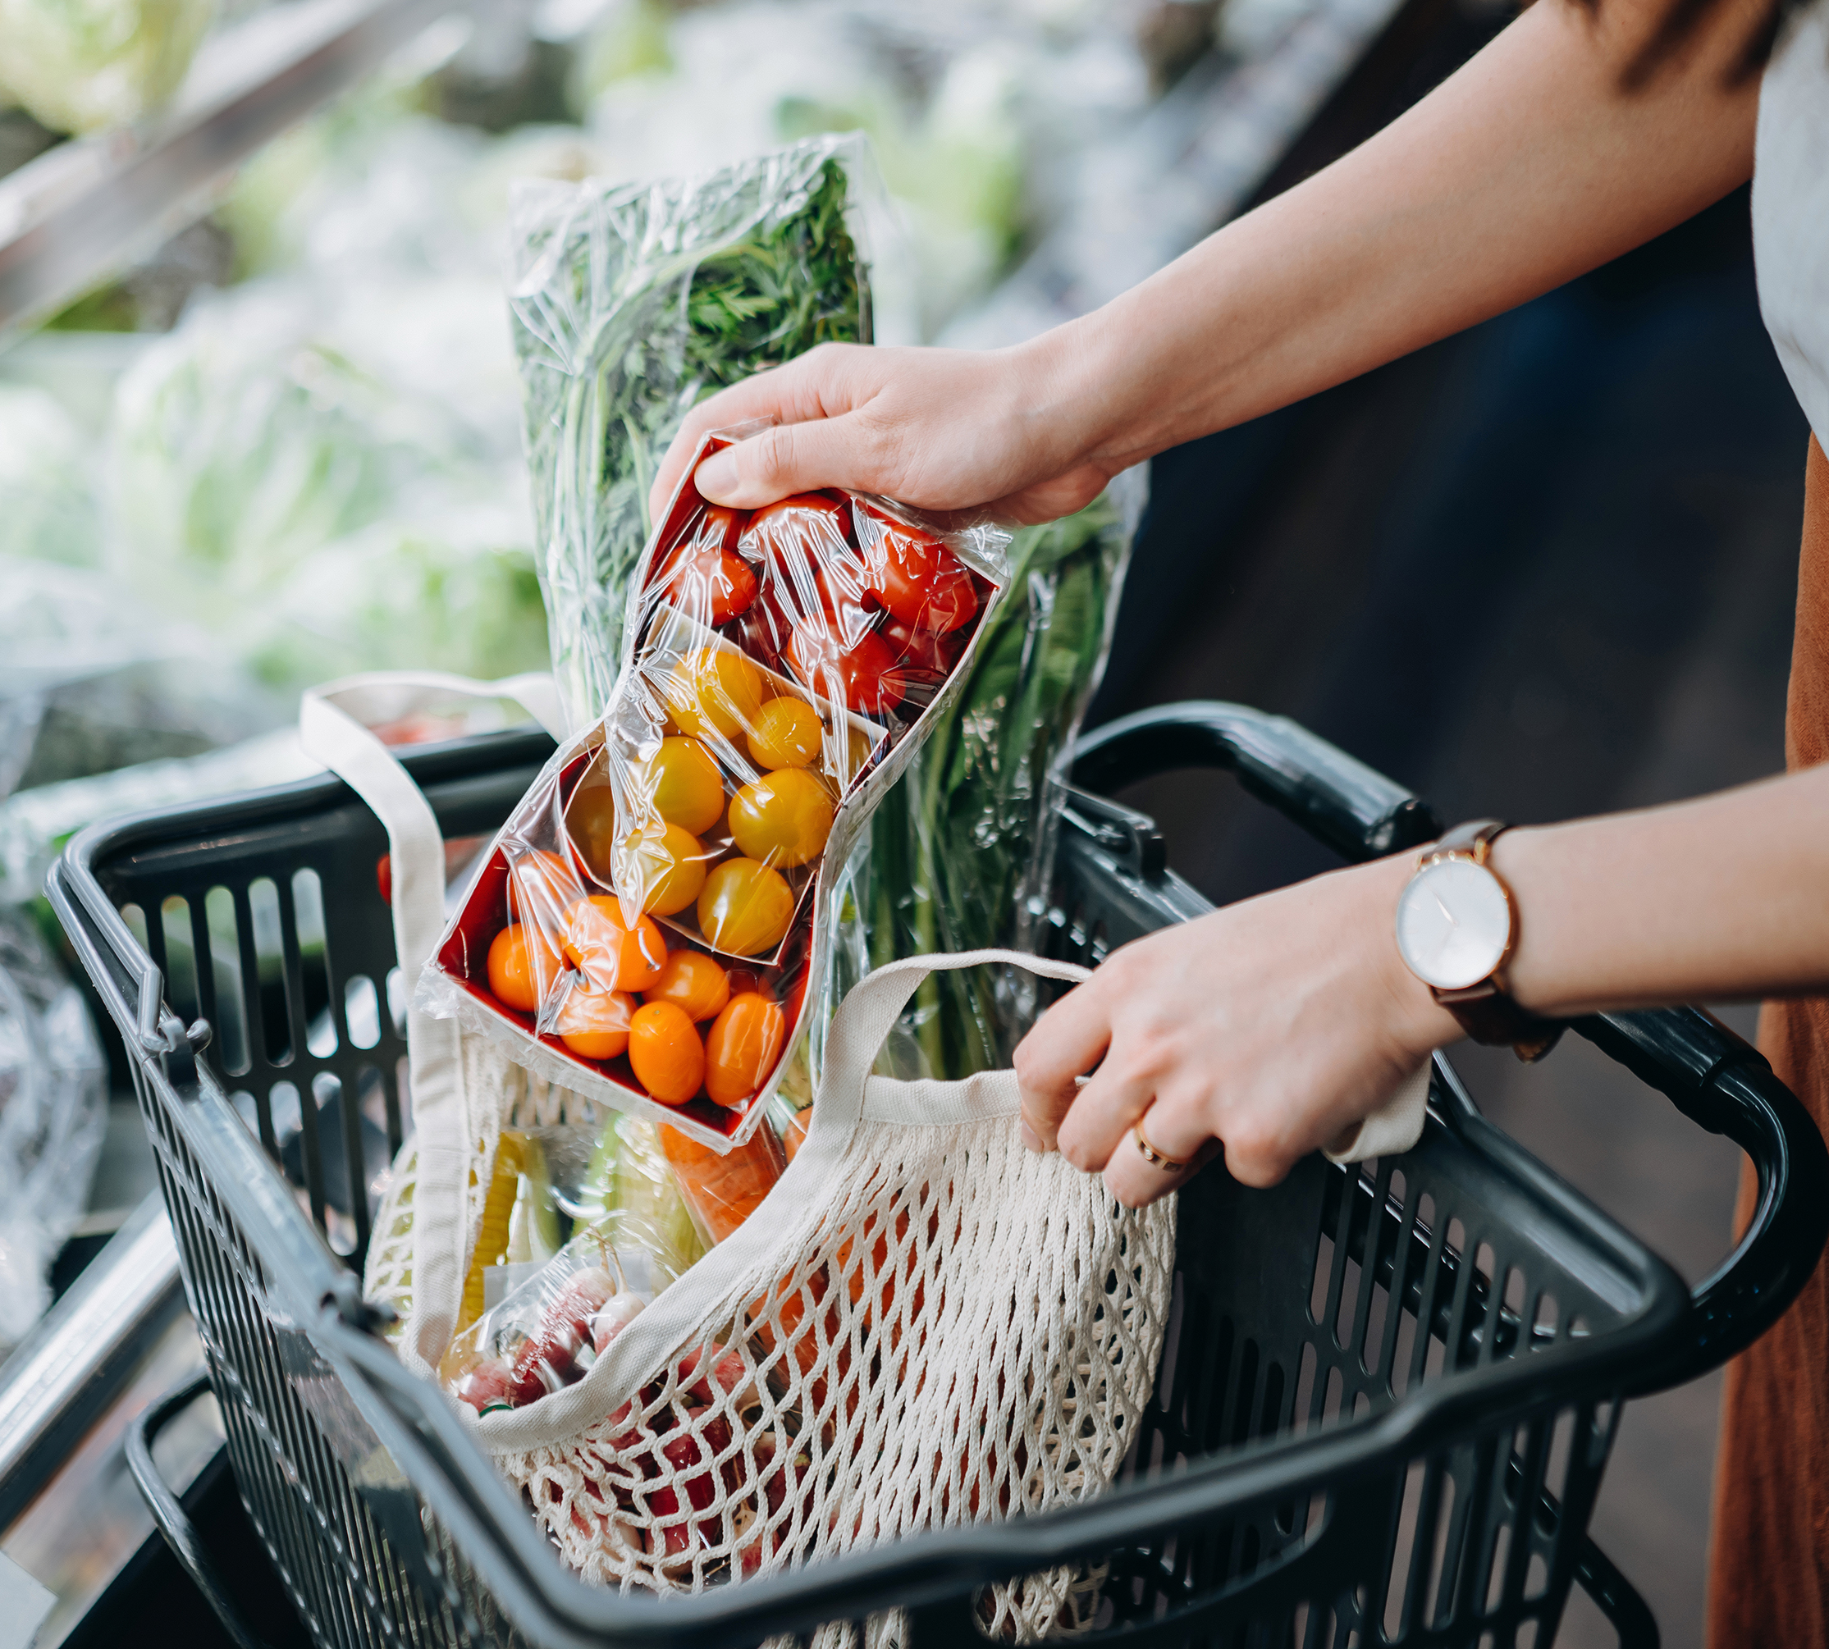
AY 24/25.
Group highlights & developments.
F&V remains important traffic driver in all retail segments
Solid management of economic circumstances, supply chain and weather conditions throughout the Group
Strong focus on operational performance and further streamlining the Group
Ready for CSRD reporting and significant progress in realizing ESG ambitions
Announcement of a voluntary and conditional takeover bid on all Greenyard shares by the Deprez family and Solum Partners LP, through Garden S.à r.l., supported by the Board

Slide 6






Key figures.
Increase in net sales (LfL): +5,1% to € 5,3bn, driven by a volume increase of 2,9%, price increases of 1,3% and an increase of service sales of 0,9%.
Due to restructuring costs, higher depreciations and taxes, a lower financial result the Net result of -€ 2,9 million lands -€ 18,1m below last year.
Adjusted EBITDA decreases with € 3,5m, landing at € 183,0m.
Net Financial Debt drops by 3,7% to € 256,5m, despite the impact of increasing inventories and the acquisition of Crème de la Crème. Leverage improves slightly from 1,87x to 1,86x.
The Board will propose not to pay a dividend.

Slide 7
Highlights per segment (Like-for-Like).
Different market dynamics in Fresh vs Long Fresh.
Fresh Segment
Long Fresh Segment (Frozen + Prepared)
  Sales growth of 5,9%, mainly thanks to volume of 4,8% with existing ICRs, 0,4% price increases and 0,7% other
  Growth ICR from 79% to 80% of the sales
  Higher sorting and packing costs due to bad product quality (weather conditions)
  Continued price pressure in the German market
  Divestment France and streamlining cost structure of Germany ongoing
  Sales growth of 1,7%, thanks to price (5,1%), negatively compensated by decreased volume
  Increased convenience sales (Frozen and Prepared)
  Capacity expansion to meet consumer demand e.g. new carton packaging line
  Higher production costs due to lower product yields and need for additional cleaning (wet weather conditions)
  Support of Gigi brand with marketing campaign

Slide 8





ESG.
Ambitions & realisations.
CO₂
Scope 1 & 2: Good progress towards our 25-26 reduction target by switching to green electricity and low-carbon fuels in key markets & continued energy-efficiency improvements
Investment in solar on rooftops and windmill project ongoing in Bree
Scope 3 supplier engagement is increasing yoy
Water
Increased water uptake vs LY due to increased processing volumes and climatic conditions leading to less predictable and interrupted supply
2 large water re-usage projects in order to reach our long term targets are waiting for permits
Waste
Share of waste diverted from disposal stable at ca. 96%
Further focus on waste streams directed to disposal
Packaging
Phasing-out non-recyclable multilayer packaging
Today >99,5% recyclable
Responsible sourcing
>90% of purchased volumes in high and medium risk countries certified for social compliance
Continued focus and positive outlook

Slide 9
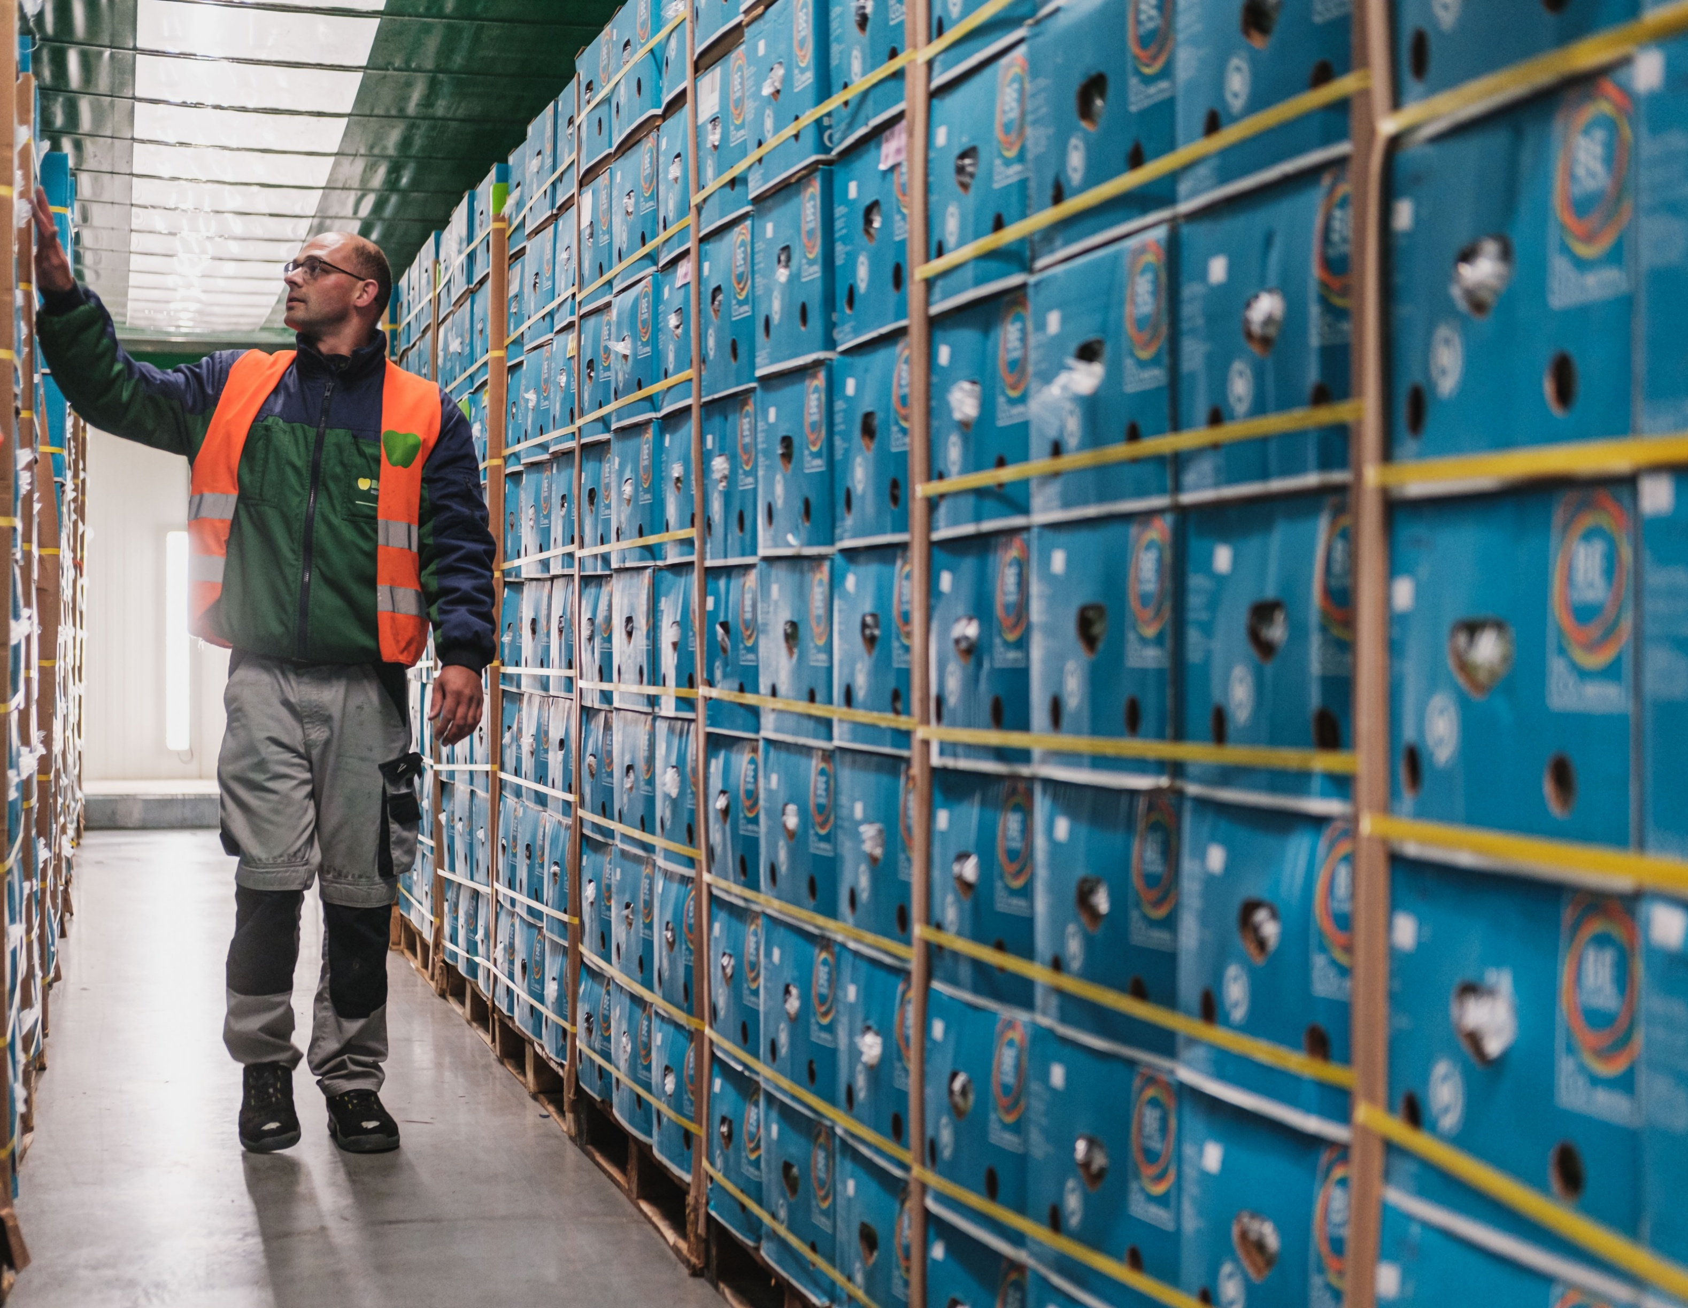
All about Greenyard
Financial review
Group

Slide 10
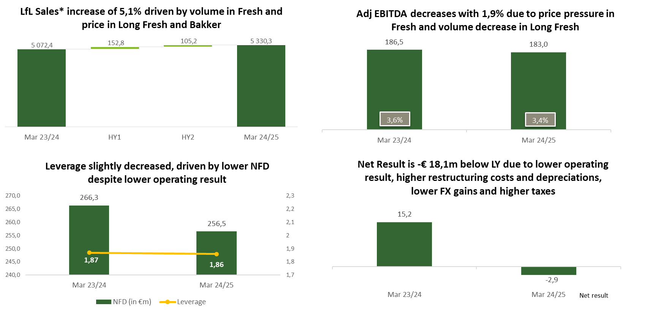
Summary key financials.
Net result is € 18,1m below LY due to lower operating result (€ 3,5m), higher restructuring costs (€ 2,1m), depreciations (€ 5,0m), FX impact (€ 3,0m) and taxes (€ 3,9m).
1
2
+3,0%
+2,1%
P: +1,3%
Q: +2,9%
O: +0,9%
Adjusted EBITDA
margin
In €m
In €m
3
4
  Pre-IFRS 16 calculation
In €m
**Reported sales: € 5135,8m YTD Mar 23/24 and € 5363,1 m YTD Mar 24/25 // * Divestments: Fresh UK in March 2022 and Fresh France in March 2023

Slide 11
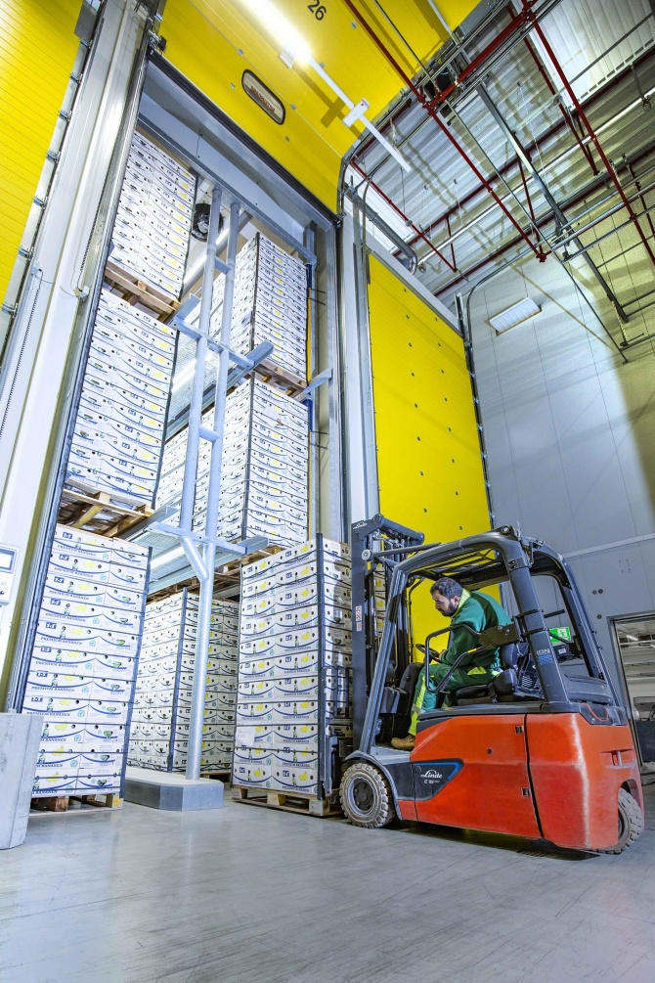
Group results.
 | AY 24/25 | AY 23/24
Net Sales - €’m | 5 363,1 | 5 135,9 | 4,4%
Gross Profit - €’m | 420,9 | 404,3 | 4,1%
Gross profit margin | 7,8% | 7,9%
Adjusted EBITDA - €’m⁽¹⁾ | 183,0 | 186,5 | -1,9%
Adjusted EBITDA margin | 3,4% | 3,6%
EBITDA - €’m⁽¹⁾ | 174,7 | 180,3 | -€ 5,6m
EBIT - €’m | 61,3 | 71,9 | -€ 10,6m
Result Before Taxes - €’m | 6,1 | 20,3 | -€ 14,2m
Net Result - €’m | -2,9 | 15,2 | -€ 18,1m
Diluted EPS - € | -0,09 | 0,28
APM measure definitions included at the end of this presentation.

Slide 12
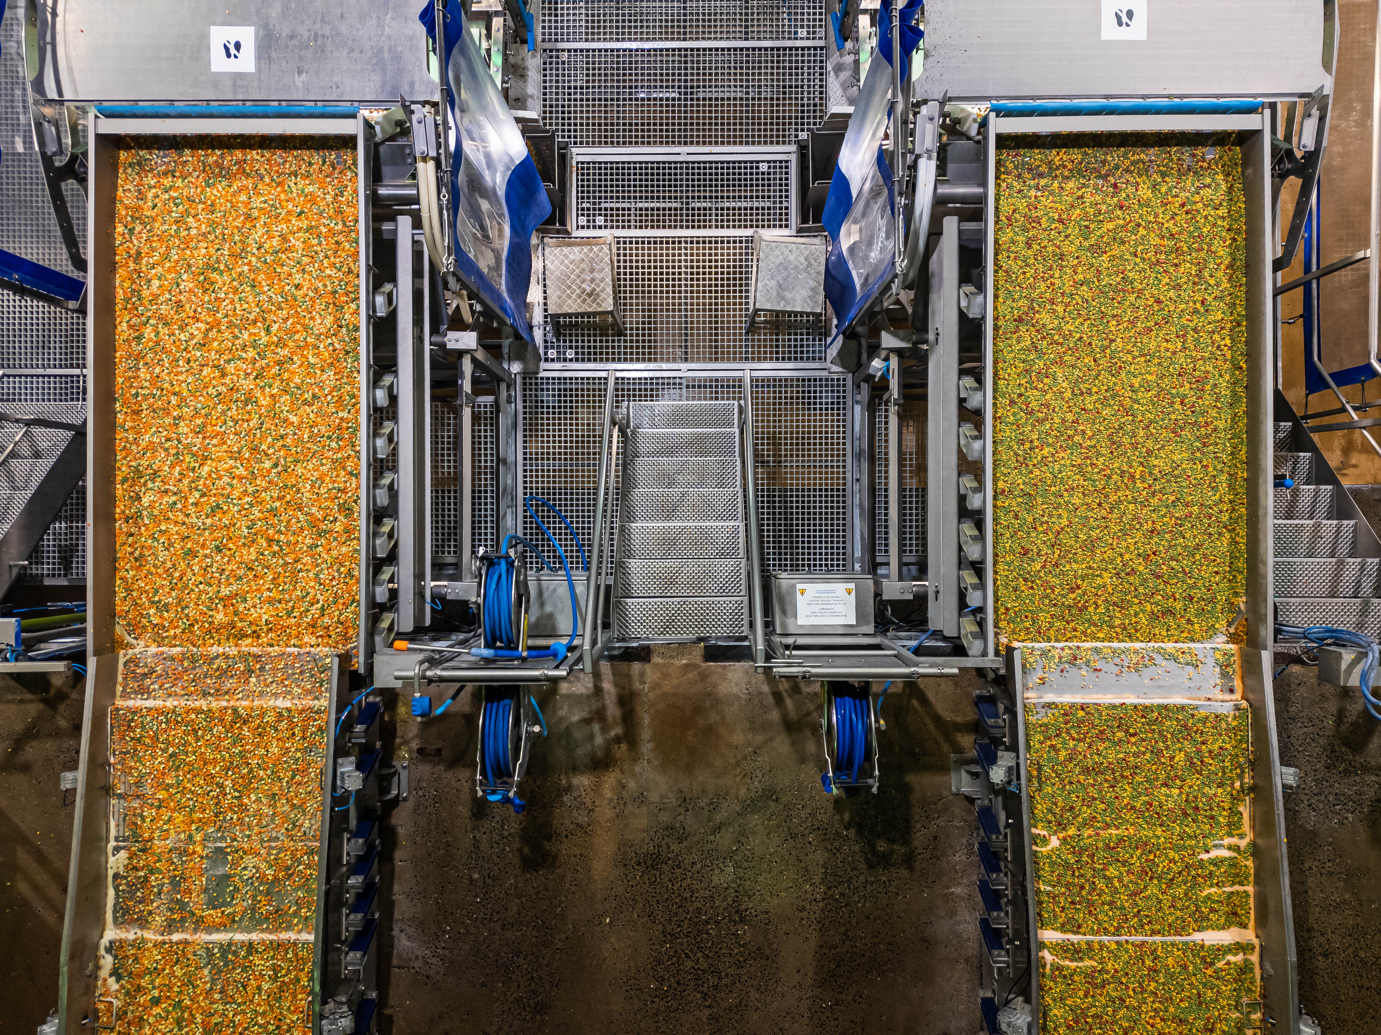
All about Greenyard
Financial review
Segments Fresh & Long Fresh

Slide 13
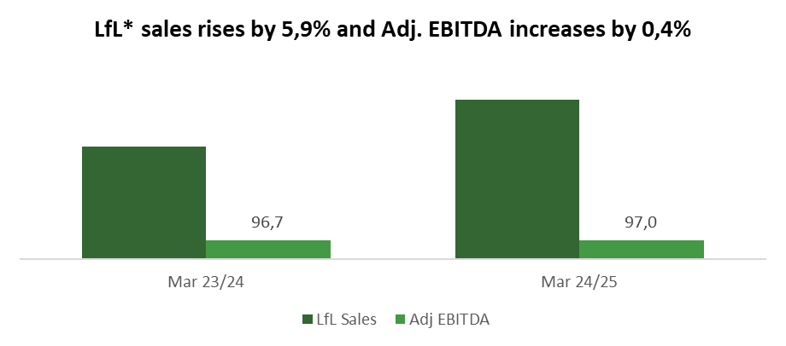
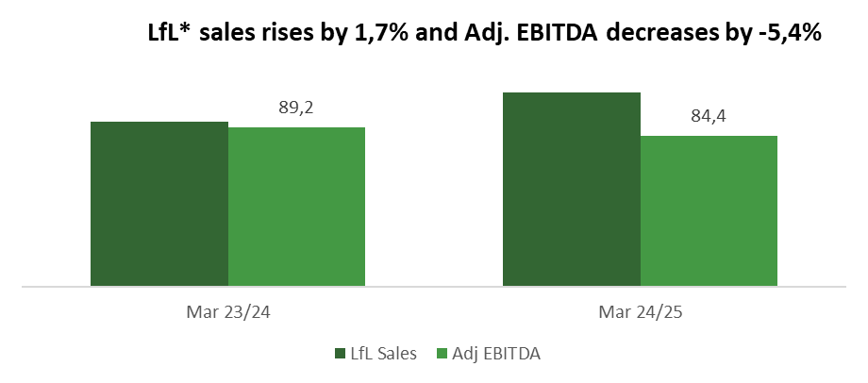
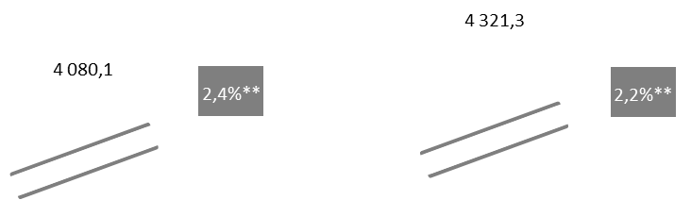
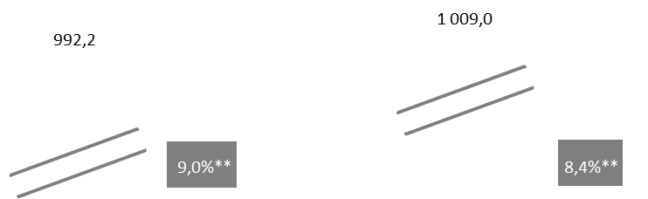
Key financials segments.
Sales growth in both segments.
Fresh
Long Fresh
  LfL Fresh sales increased by 5,9%, or € 241,2m to € 4 321,3m
  Sales in ICR grow from 79% to 80% of Fresh Sales YoY
  Sales growth mainly through volume growth (4,8%), a positive price effect (0,4%) and an increase in service sales (0,9%)
  Adjusted EBITDA +€ 0,3m YoY
  Stable Adjusted EBITDA thanks to strong volume growth, despite margin pressure in the German market, higher sorting and packing activities and an early easter, accounted for in 23/24
  LfL Long Fresh sales increased by +1,7% to € 1,0m, mainly through price increases (+5,1%) and transport recharges (+1,4%), partially offset by lower volumes (-4,9%)
  Adjusted EBITDA decreased by € 4,8m
  Lower Adjusted EBITDA due to decreased volumes, especially in the canning business, increased fruit prices, worse raw material and labour yields due to bad product quality because of the weather conditions
  Margin decreases to 8,4%

Slide 14
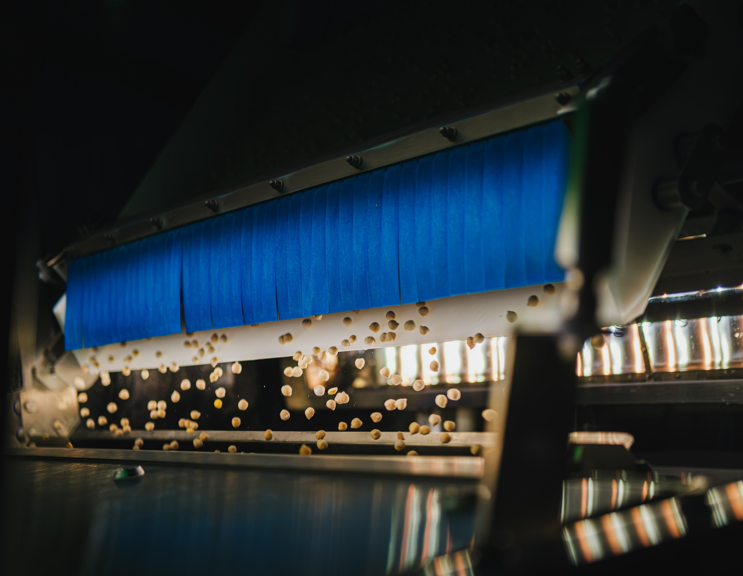
Presentatie door het uitvoerend management
Capital allocation
& leverage

Slide 15
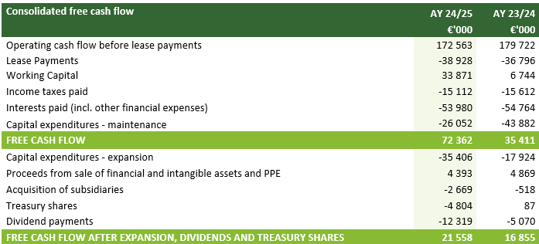
Cash flow statement.
A Free Cash Flow of € 72,4m was generated which is € 37,0m better than LY, mainly due to improved NWC and lower maintenance CAPEX, despite higher inventory (+€ 48,4m).

Slide 16
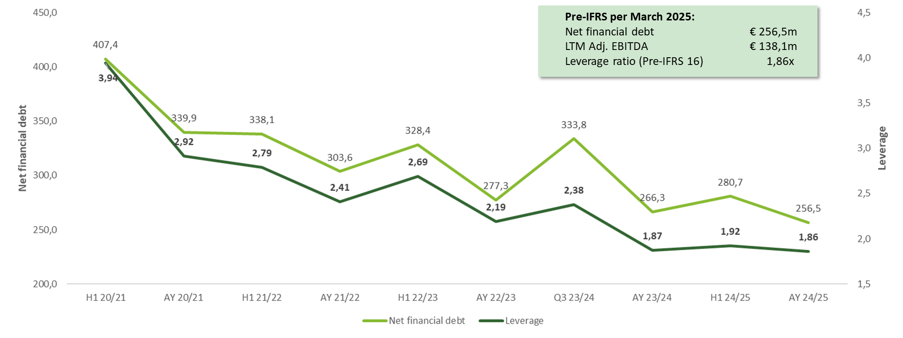
Leverage evolution (Pre-IFRS 16)*
Leverage decreased slightly from 1,87x to 1,86x compared to the same period last year.
In €m
  * Pre-IFRS 16 covenant, conform bank definition

Slide 17
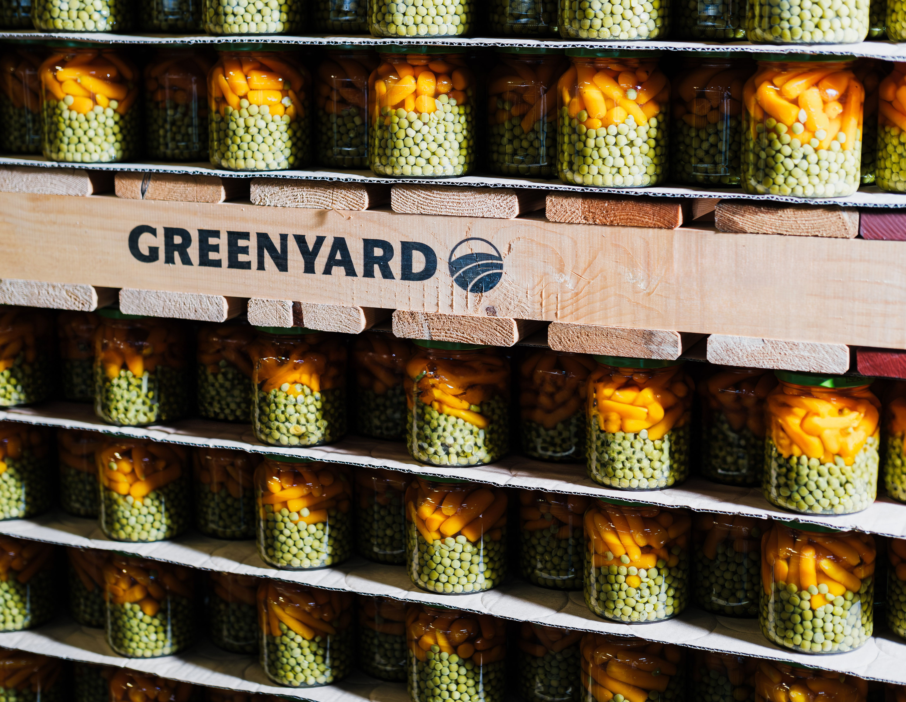
All about Greenyard
Strategic priorities
& outlook

Slide 18






Strategy 2030.
Implementation for the coming years.
Promote “pure-plant”
Reach Sustainability targets together with partners in the chain
Expand ICR customers and build across divisions (and beyond retail): e.g. Sligro Food Group
Build on opportunities with current customers
Co-creating with growers
Connect entire food chain in Frozen through collaboration with Gelagri
Ensure availability of the product for our customer at all time
Moments of consumption: momentum with pure plant ice and launch PlanTasty
Focus on consumer needs with customers: formats & convenient nutritious solutions in pure-plant
Invest in infrastructure, improve efficiency & operational excellence
State-of-the-art mechanized service centre and sorting lines
Create further diverse talent pool.
Health and sustainability
Unique
ICR
Growing expertise & network (IGR)
Impactful
Innovation
Operational Excellence
Performance with Human culture

Slide 19
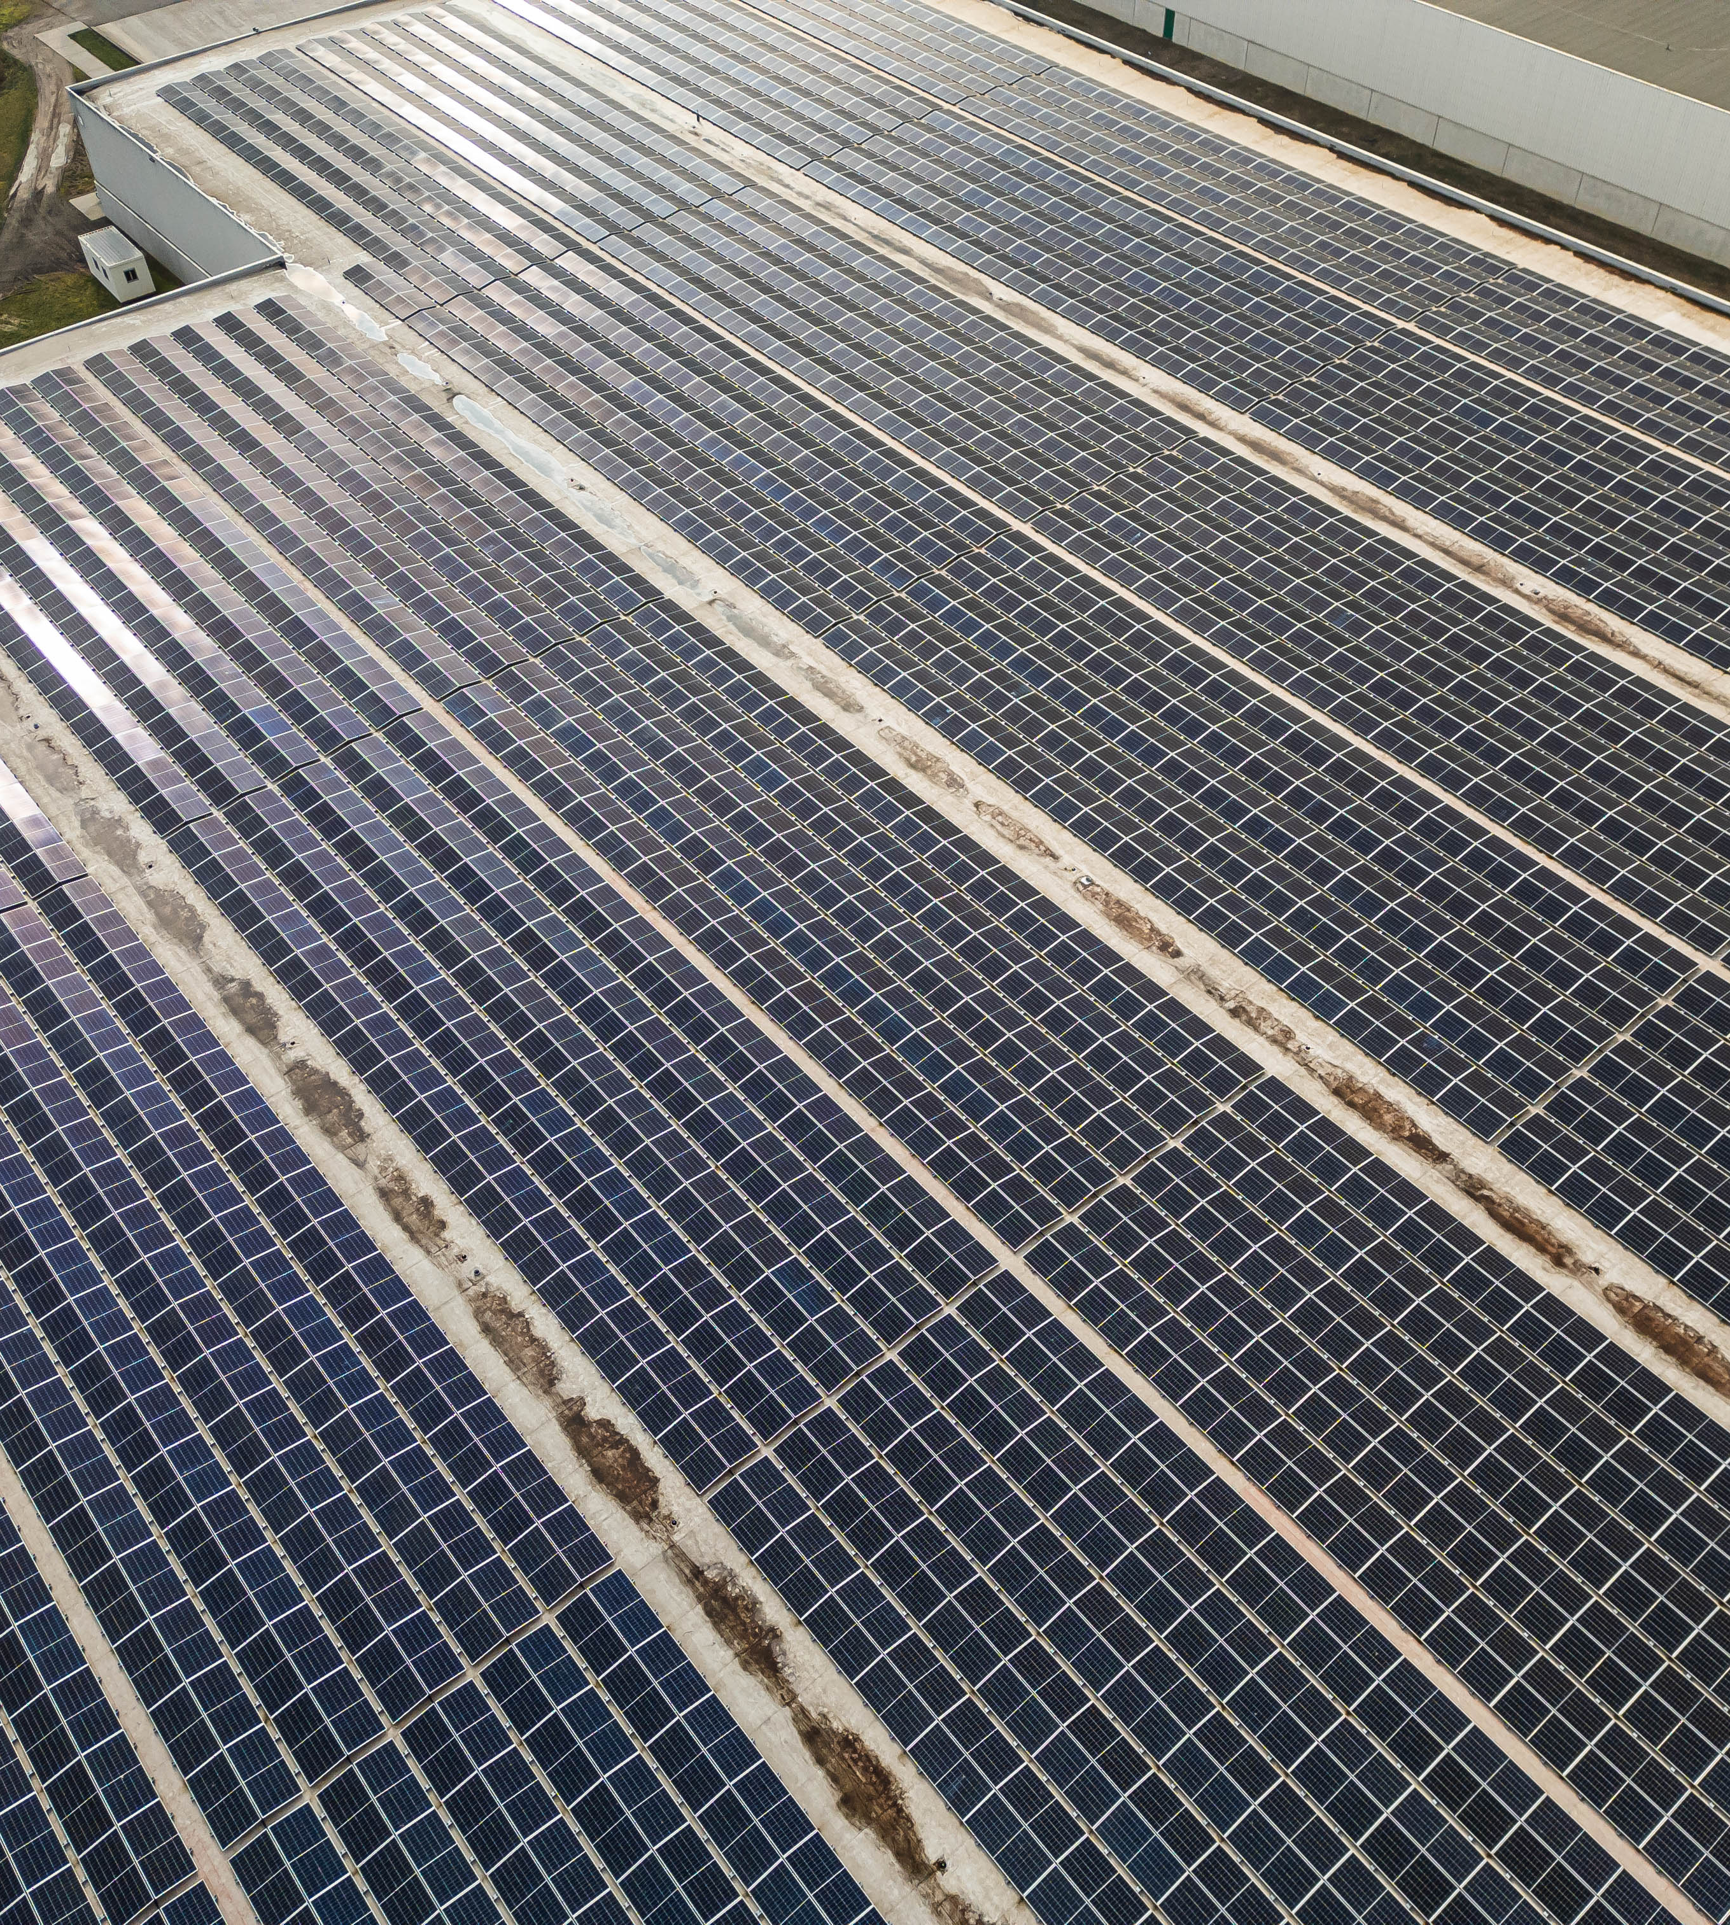
Outlook.
€ 5,4bn by March ’26
€ 190-200m by March ‘26
Net Sales
Adj. EBITDA
Notes:
[FRANCIS]

Slide 20
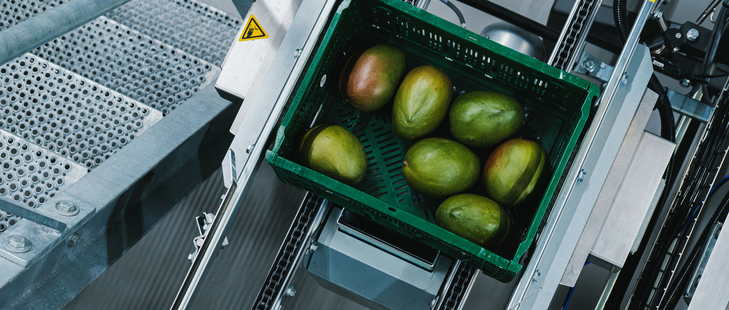
Q&A

Slide 21
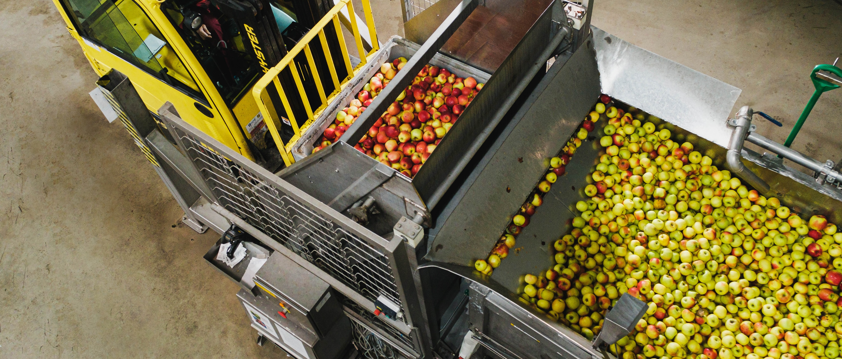
Appendix

Slide 22
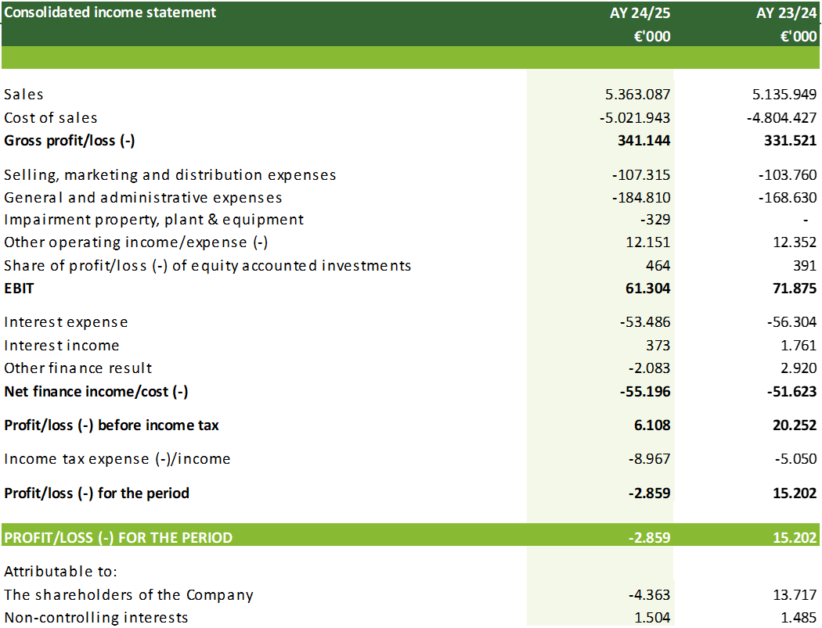
Consolidated income statement.

Slide 23
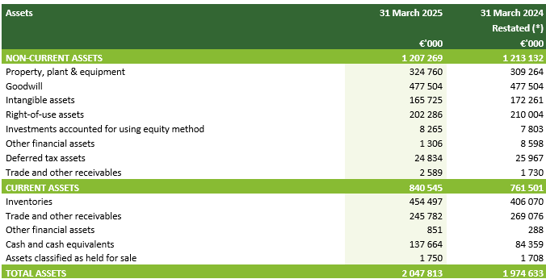
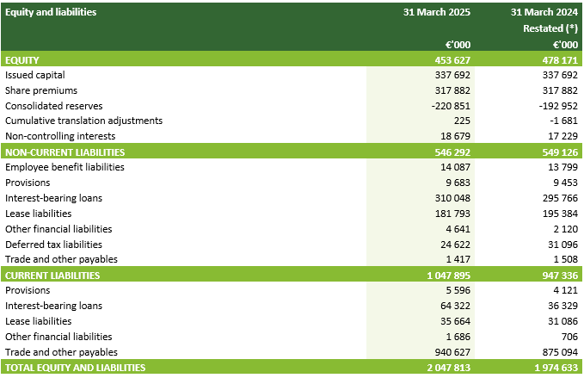
Consolidated statement of financial position.
(*) During AY 24/25, the Group identified an historical error in the calculation of deferred taxes amounting to € 11,4m which primarily related to tax rate changes pre AY 22/23 that were not correctly applied to calculate deferred taxes on temporary differences with respect to customer relationships. Consequently, opening equity as per AY 23/24 and AY 24/25 was overstated by € 11,4m, deferred tax assets were overstated by € 1,4 m and deferred tax liabilities understated by € 10,0m. The error has been corrected by restating each of the affected financial line items for the prior periods. This error did not materially affect the income statement of either AY 23/24 and AY 24/25.

Slide 24
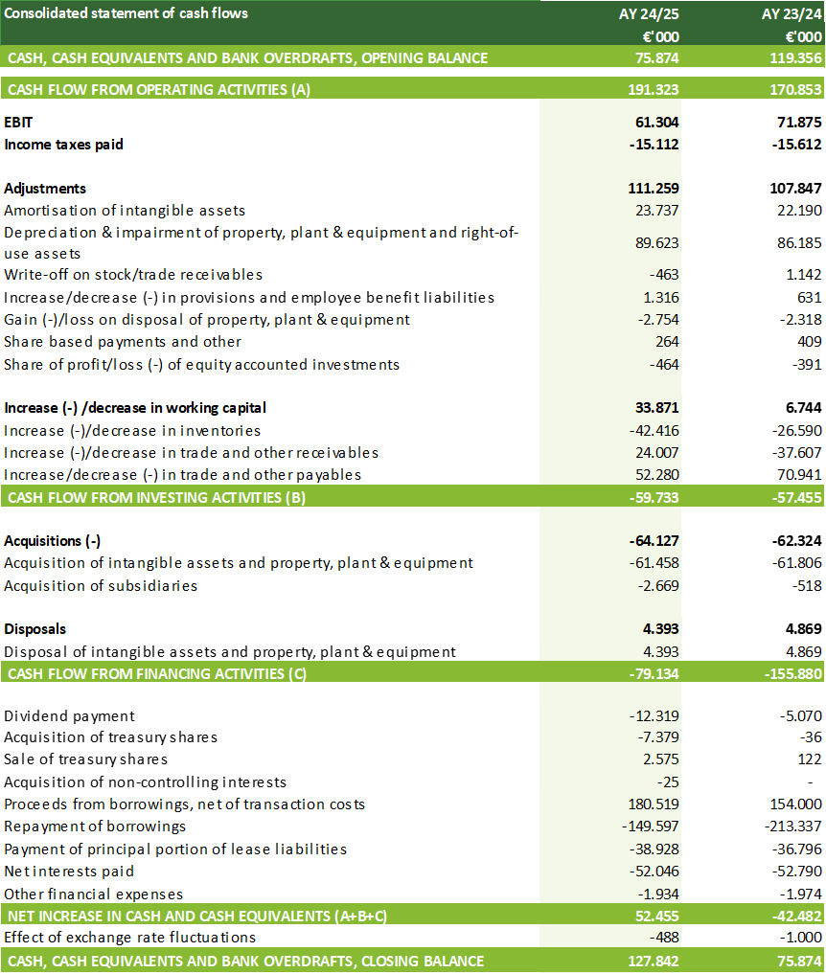
Cash flow.

Slide 25
Reconciliation net financial debt.

Slide 26
Adjustments made for one-off items from operating activities.

Slide 27
Definitions.
CAPEX | Capital expenditures
EBIT | Operating result
EPS | Earnings per share
ICR | Integrated Customer Relationships
IRS | Interest rate swap
Liquidity | Current assets (including assets classified as held for sale)/Current liabilities (including liabilities related to assets classified as held for sale)
Leverage | NFD (for leverage) / Adjusted EBITDA (for leverage)
Net financial debt (NFD) | Interest-bearing debt (at nominal value) after the impact of lease accounting (IFRS 16), less derivatives, bank deposits, cash and cash equivalents and restricted cash
Net financial debt (NFD) excl. lease accounting | Interest-bearing debt (at nominal value) before the impact of lease accounting (IFRS 16), less derivatives, bank deposits, cash and cash equivalents and restricted cash
NFD (for leverage) | Net financial debt (NFD) excl. lease accounting
Net result | Profit/loss (-) for the period
Adjusting items | Adjusting items are one-off expenses and income that in management’s judgement need to be disclosed by virtue of their size or incidence. Such items are included in the consolidated income statement in their relevant cost category, but separately disclosed in the chapter Key financial information reconciling EBIT to Adjusted EBITDA. Transactions which may give rise to adjusting items are principally restructuring and reorganisation activities, impairments, disposal of assets and investments, claims, IFRS 3 acquisition accounting and corporate finance related projects and the effect of the accelerated repayment of certain financial indebtedness.
Adjusted EBITDA | EBIT corrected for depreciation, amortisation and impairments excluding adjusting items, excluding EBIT corrected for depreciation, amortisation and impairments from minor operations that are divested or divestment is in process (not within the scope of IFRS 5).
LTM | Last twelve months
LTM Adjusted EBITDA | Last twelve months Adjusted EBITDA, corrected for acquisitions and disposals on a like-for-like basis
LTM Adjusted EBITDA (for leverage) | Last twelve months Adjusted EBITDA, corrected for acquisitions and disposals on a like-for-like basis and excluding the impact of lease accounting (IFRS 16)
Working capital | Working capital is the sum of the inventories, trade and other receivables (non-current and current) and trade and other payables (current). In this respect trade and other receivables are corrected for long-term (financing) receivables and accrued interest income and trade and other payables exclude accrued interest expenses and dividend payable.
Sales (like-for like) | Reported sales of the period adjusted for operations that are divested or divestment is in process
AY 24/25 | Accounting year ending 31 March 2025
AY 23/24 | Accounting year ended 31 March 2024
H1 24/25 | First half year of accounting year ending 31 March 2025
H1 23/24 | First half year of accounting year ended 31 March 2024

