Slide 1
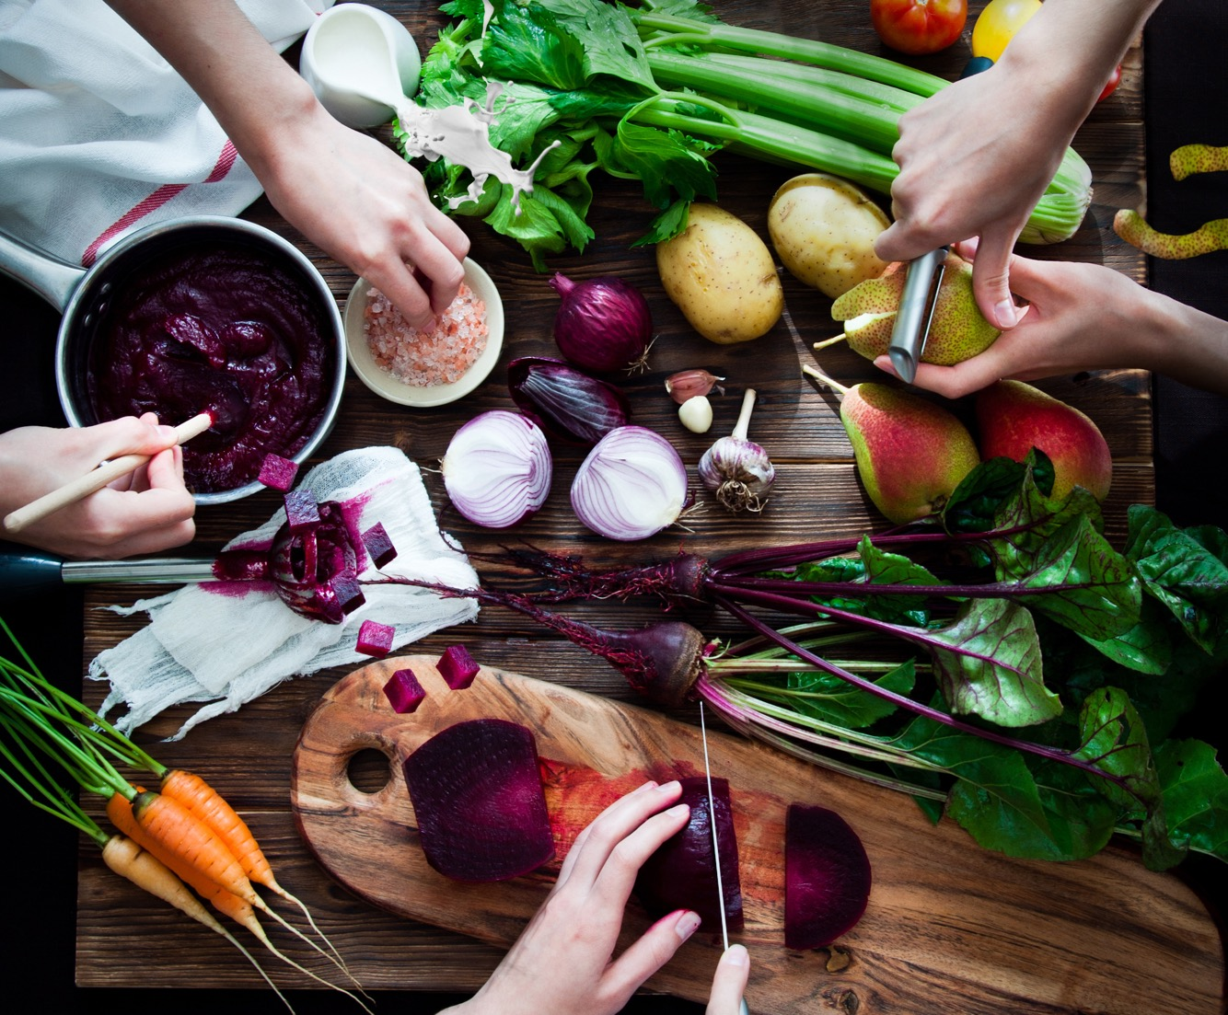

A Pure Plant Powerhouse
Key financials
H1 2023/24
Notes:
DENNIS:
Welcome everyone and good afternoon. Thank you for joining our HY 2023-2024 earnings conference call, which is also the first call in our festive 40th year of existence.
My name is Dennis Duinslaeger, IR and Strategy director at Greenyard. I hope you had the chance to review the press release that was issued earlier this morning CET. You may also visit the company’s website on www.Greenyard.group for a copy of today’s release as well as to register for future distribution. This call will also be available for replay in the coming days.

Slide 2
Safe Harbour & disclaimer
Notice to and undertaking by Recipients
This presentation does not purport to be all-inclusive or to contain all of the information that the Recipient may require. The company expressly disclaims any and all liability relating to or resulting from the use of this presentation. This presentation may not be reproduced, forwarded to any person or published, in whole or in part. This presentation does not constitute an offer to sell or the solicitation of an offer to buy any security. The information contained herein is for informational purposes and may nbot be relied upon in connection with the purchase or sale of securities of the company.
Forward-looking statements
This presentation may contain forward-looking statements. Such statements reflect the current views of management regarding future events, and involve known and unknown risks, uncertainties and other factors that may cause actual results to be materially different from any future results, performance or achievements expressed or implied by such forward-looking statements. Greenyard is providing the information in this document as of this date and does not undertake any obligation to update any forward-looking statements contained in this presentation in light of new information, future events or otherwise. Greenyard disclaims any liability for statements made or published by third parties and does not undertake any obligation to correct inaccurate data, information, conclusions or opinions published by third parties in relation to this or any other document issued by Greenyard.
Industry information
Market data and industry information used throughout this presentation are based on management’s knowledge of the industry and the good faith estimates of management.. We also relied, to the extent available upon management’s review of independent industry surveys and publications and other publicly available information prepared by a number of third-party sources. All of the market data and industry information used in this presentation involves a number of assumptions and limitations, and you are cautioned not to give undue weight to such estimates. Although we believe that these sources are reliable, we cannot guarantee the accuracy or completeness of this information, and we have independently verified this information. While we believe the estimated market position, market opportunity and market size information included in this presentation are generally reliable, such information, which is derived in part from management’s estimates and beliefs, is inherently uncertain and imprecise. Projections, assumptions and estimates of our future performance and the future performance of the industry in which we operate are necessarily subject to a high degree of uncertainty and risk due to a variety of factors, including those described above. These and other factors could cause results to differ materially from those expressed in our estimates and beliefs and in the estimates prepared by independent parties.
Non-IFRS Financial Measures
In this presentation, we use certain economic and financial indicators that are not defined as accounting measures IAS-IFRS, which, however, allow to discuss the Group’s business. These figures are used to comment on the performance of the Group. The alternative performance indicators should be used as a supplement to those provided in accordance with IAS-IFRS to assist users of the presentation and Report in better understanding the Group’s economic, equity and financial performance.
Glossary
All definitions are available in the Glossary of the Annual Report and Half Year Report
Notes:
DENNIS:
I would like to remind you that some of the information we will be speaking to you about today, including the answers given in response to your questions, may include forward looking statements. These reflect the current views of management regarding future events and may involve known and unknown risks, uncertainties and other factors that may cause actual results to materially differ from such performance. Greenyard is providing the information in this document as of this date and does not undertake any obligation to update any forward-looking statements contained in this presentation considering new information, future events or otherwise. Greenyard disclaims any liability for statements made or published by third parties and does not undertake any obligation to correct inaccurate data, information, conclusions or opinions published by third parties in relation to this or any other press release issued by Greenyard.

Slide 3
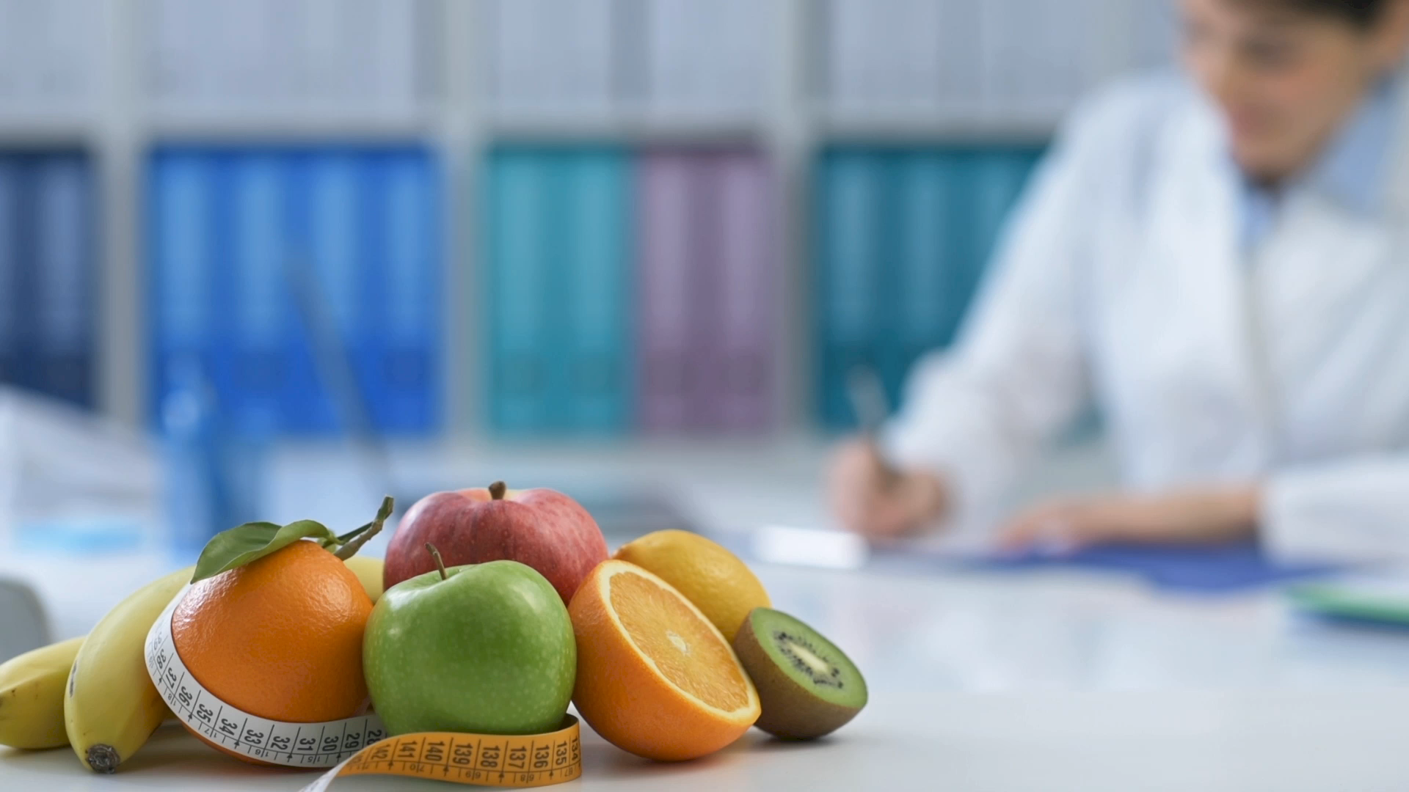
Agenda
01
Half Year 2023/2024 Highlights
02
Operational Review
03
Financial Review
04
Full Year 2023/2024 Outlook
05
Questions and Answers
Notes:
DENNIS:
Today, we will be able to give more information on our highlights, operational and financial review, as well as give you our thoughts around the outlook.

Slide 4
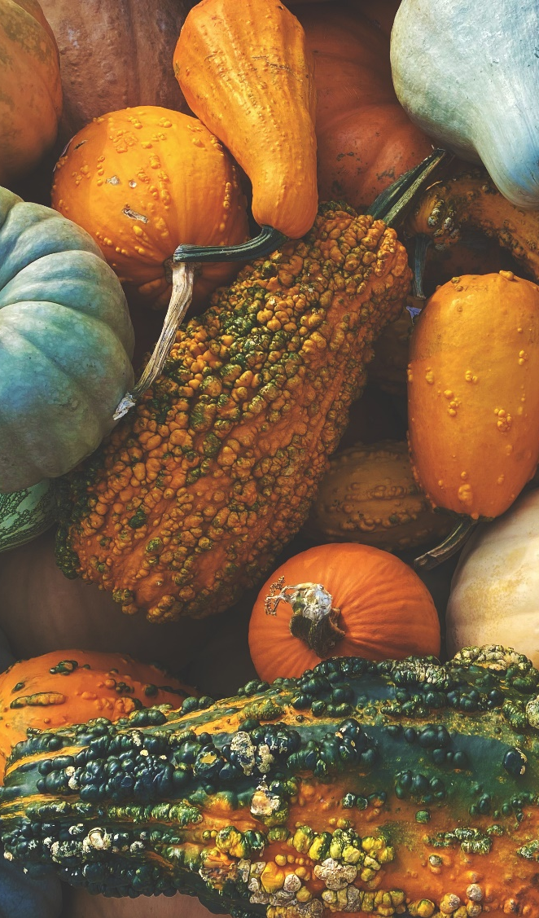
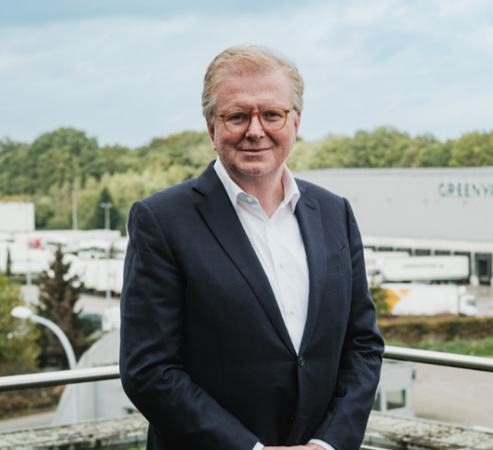
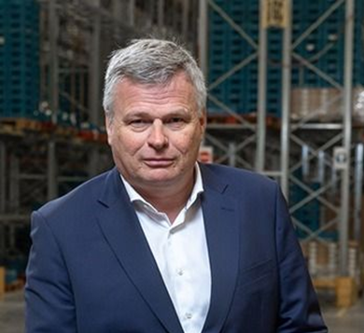
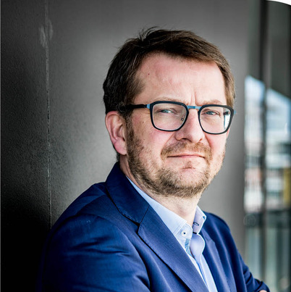
Our Senior Management Team and Today’s Speakers
Hein Deprez
Co-CEO & member of the Board
Marc Zwaaneveld
Co-CEO
Speaker today
Nicolas De Clercq
CFO
Speaker today
Notes:
Joining me in today’s call are Mr Marc Zwaaneveld, Co-CEO of the Group and Mr Nicolas De Clercq, CFO of the Group. And with that, I am pleased to turn today’s call over to Marc. Marc, the floor is yours.

Slide 5
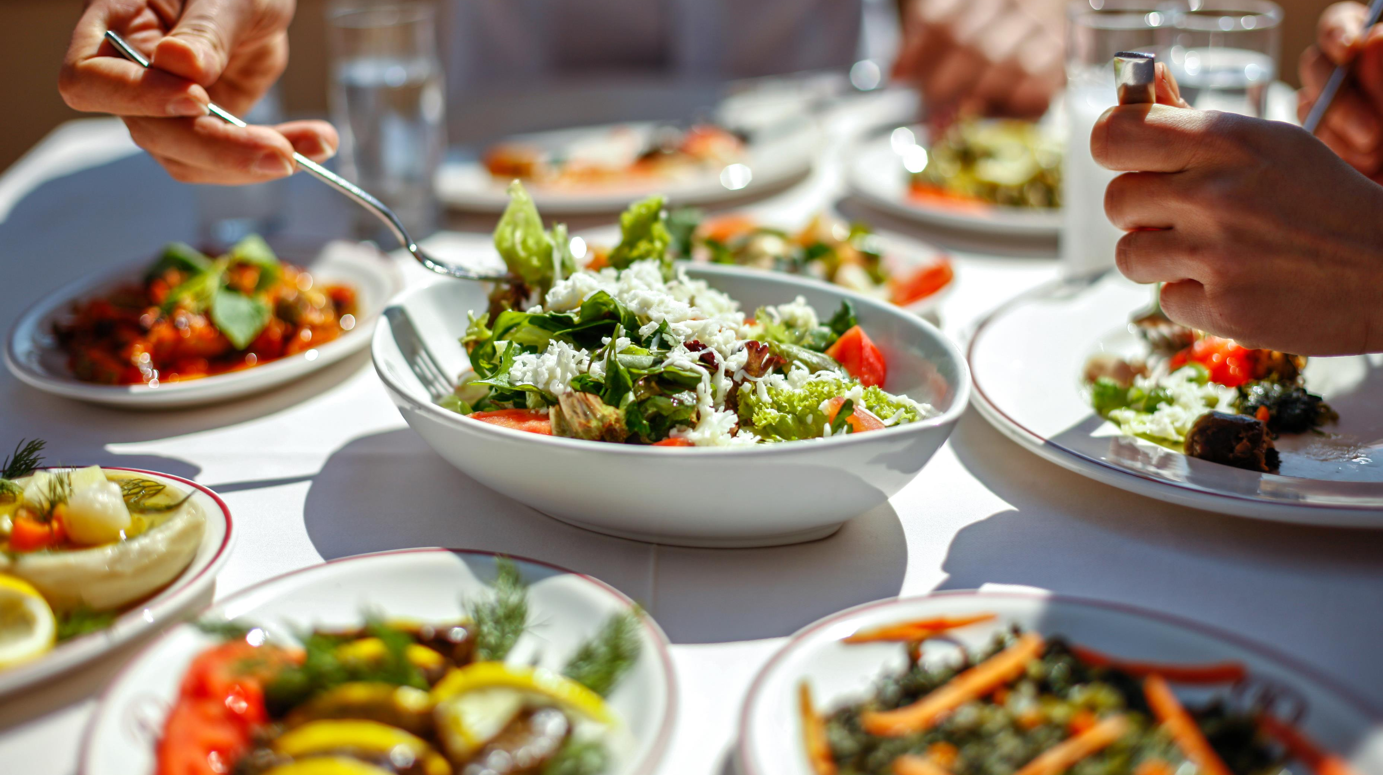
Half Year
2023/2024
Highlights
Notes:
MARC:
This year we celebrate our 40th year.
The organisation has been built over 1 generation and is truly unique in the combination of fresh, frozen and ambient fruit and vegetable food solutions, as well as in its future-proof, sustainable model of integrating the chain with the customer and forging long-term relationships with the growers.
Our first half year also shows the strength of the organisation and the business model, in addition to the ambitious sustainability targets we have set and were we are in reach of the target.
The first half year continued to be marked by inflation, high volatility and global geopolitical turmoil. Even in these circumstances, our colleagues have risen above and beyond to continue the strong performance of the past periods.

Slide 6
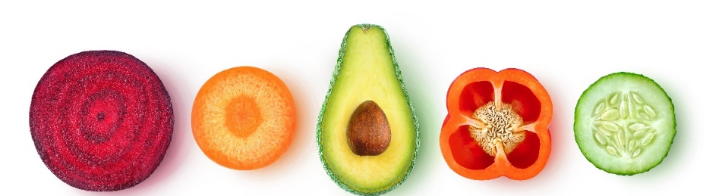
Half Year 2023/2024 Highlights
Net Sales
H1 ‘23 | H1 ’22 | Variance | Variance LfL
2 521,3 | 2 301,9 | 9,5% | 11,2%
Adjusted EBITDA
H1 ‘23 | H1 ’22 | Variance
90,3 | 80,4 | 12,3%
Net Financial Debt | Leverage
H1 ‘23 | H1 ’22 | Variance
316,0 (2,4x) | 328,4 (2,7x) | -3,8%
Further market share gain.
Strong results in H1 driven by volume growth and inflation compensating actions in both segments.
Adjusted EBITDA increasing even faster thanks to strong processing in Long Fresh and process efficiencies.
New ICR. Already 1 new ICR, before end calendar year 2nd new ICR. Potential third ICR could follow soon after.
Low debt and leverage ratio continues. € 12,4m debt reduction despite € 44m increase of inventory.
Net result stable at € 7,0m.
All sustainability targets within reach.
Notes:
MARC:
First of all, unfortunately, from our consumer side, we do not yet see a recovery to post-COVID volumes. Inflation is still impacting market volumes, and that would certainly be the case in Fresh.
Based on our increase in volumes in Fresh, on top of last year, Greenyard continues to build further market share.
Revenues increased by double digits, backed by both volume growth and inflation compensation actions in both segments.
We have been able to price in the necessary cost increases in the supply chain, in all transparency and fairness towards our customers.
What is even stronger, is the Adjusted EBITDA performance, which increased even faster than Net Sales!
This was driven by the strong processing in Long Fresh, but also thanks to further process efficiencies in our “continuous improvement” mindset and program. It shows that we continue the track record to improve period on period.
We created € 12,4m of cash to reduce our debt, even despite € 44m inflation impact on the inventory. I am glad to say that our debt level and leverage ratio remains low versus our peers of industry average.
Our net result is stable versus last year at € 7m. It shows that even in these highly volatile and disrupted market conditions (weather, climate, war and supply chain disruptions), combined with a global increase in financial benchmark rates (in our case mainly the EURIBOR), we managed to generate stable positive bottom-line results. We continue working on our bottom line.
Equally important as our financial performance, is our sustainability performance. I am delighted to say that also there, all targets are in reach in this interim period and we are on course to reach all of them by the end of the year.

Slide 7
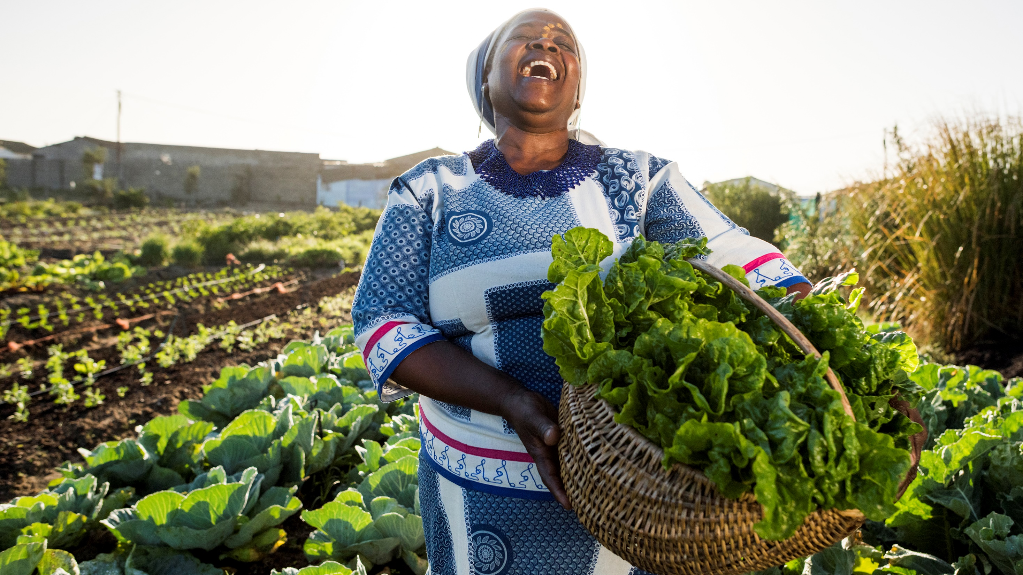
Operational
Review

Slide 8

Operational Review
Fresh
Growth thanks to increase ICR revenues (74% to 78%)
+2,4% higher volumes
+7,6% higher prices
Improved warehouse fill rates and efficiencies Poland
Higher costs GER and US
Investments in automation
Long Fresh
Volumes (-1,7%) from lower stock levels held by customers
Prices (+18,9%) thanks to inflation compensation
Benefitting from full assortment
IGR: Higher crop yields and higher cost absorption
Investments in convenience
Sustainability
All sustainability targets in reach
Strict monitoring on all entities
Notes:
MARC:
Looking at our operations and our segments, both segments have performend very well.
In Fresh, we noted a further increase in the revenues in the Integrated Customer model, from 74% of total fresh sales to 78% with the addition of the volumes of our lastest ICR customer, Dohle Hit.
In that respect, we repeat that we expect two more customers to follow suit in the coming period, of which one where we are in discussion to expand the assortment from fresh to frozen and prepared. More information will be provided to the market as soon as possible.
In Fresh, volumes have again increased versus a decrease in the last period as consumers’ wages and salaries are following inflation in certain of our markets. Still, there is room for further bounce back to levels post COVID-19.
Prices have also increased materially, to reflect the inflationary impact on raw material prices and services. We relentlessy and openly communicate any price impact to our customers, in both segments, which is appreciated by our customers.
In Long Fresh, we have seen good crop yields and good cost absorption in our factories.
We continue to invest in both segments, in further efficiency gains through automation and mechanisation, but also investments in convenience. E.g. in Long Fresh, we invested in capacity for light coating, even with proteins, responding to further consumer requests for easy to use products. Across the group, 52% of the capex was related to maintenance and replacement.
I will hand over to Nicolas for the financial review.

Slide 9
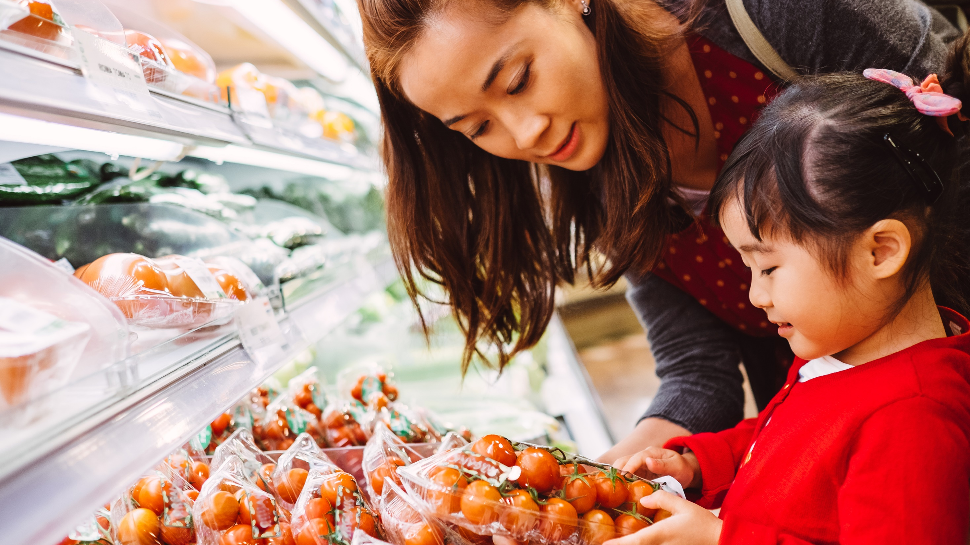
Financial
Review
Notes:
Nicolas:
Thank you Marc.
Great to be here in the call with you all on my first earnings call with Greenyard.
As you will probably know, I joined Greenyard recently as Group CFO. it is good to see a strong performance, particularly in these challenging market conditions. The strong volume and inflation mitigation measures create a platform for further growth in profitability and cash flow.

Slide 10
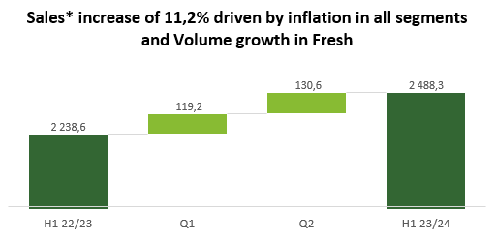
Key Financials Group | 12,3% higher EBITDA thanks to Price and Volume increase and strong processing in Long Fresh, combined with a further reduction of leverage and NFD
1
2
+10,3%
+12,1%
P: +9,6%
Q: +1,7%
O: -0,1%
Adjusted EBITDA
margin
In €m
In €m
3
4
In €m
  Pre-IFRS 16 calculation
* Reported sales: € 2 301,9m YTD Sep 22/23 and € 2 521,3m YTD Sep 23/24 // * Divestments: Fresh UK in March 2022 and Fresh France in March 2023
Notes:
NICOLAS:
Diving into the financials of H1, both quarters have seen double digit growth versus last year. I remind you that last year, inflation was already on the rise. Growth is therefore on top of last year’s growth.
After 2 quarters, we have seen volumes increase almost 2%, with prices up almost 10%.
Sales stand at 2,5bn after these first 6m.
In Adjusted EBITDA, we grow 12,3% to € 90,3m, up from € 80,4m. Taken into account that last year there was a one time water contribution of € 3.4 million in last years EBITDA, the growth is even more than 17%. It translates into a margin that grows back to 3,6%. This is driven by strong processing in Long Fresh and higher compensation for interest costs and depreciations under the ICR models.
We decrease again 12m versus last year in debt levels and leverage ratio stands at 2,4x. We keep debt levels and leverage ratio at low levels and we saw an important decrease of the leverage ratio compared to the same period last year.
Despite increasing interest rates and higher deprecations, we kept our net result stable at € 7m.

Slide 11
Key Financials Segments | Adj EBITDA growth in Fresh thanks to Bakker and Long Fresh thanks to strong crop yields and inflation management
2 032,0
456,3
Fresh
Long Fresh
1 848,0
390,6
2,6%**
In €m
In €m
8,2%**
7,9%**
2,7%**
** Divestments: Fresh UK in March 2022 and Fresh FR in March 2023 (in process)
* Adj EBITDA margin is calculated on the basis of reported sales
Notes:
NICOLAS:
In Fresh, sales increased by 10% (LfL), based on 2,4% more volumes, especially in the business with our ICR customers, and 7,6% coming from higher prices, despite significant price pressure in certain European markets.
As Marc also mentioned, the share of ICR increased, creating more stability on the long term.
The Adjusted EBITDA increased by € 2,7m thanks to the result of Fresh Poland and inflation and interest compensating measures within several ICRs.
It allowed us to keep the margin relatively stable.
In Long Fresh, Net Sales increased by almost 17%, with a small decrease in volume (-1,7%) versus strong inflation mitigating measures.
The Adjusted EBITDA increased by 21,2%, pushing the EBITDA margin from 7,9% to 8,2%. We had a good crop year and particularly a very strong pea season in the UK.

Slide 12
Net result evolution | Net Result of € 7,0m driven by a higher EBITDA and lower non-recurring costs and taxes, offset by higher depreciations and interests on the non-hedged positions of factoring programs and credit lines
 | H1 23/24 | H1 22/23 | Var.
Net Sales | 2521,3 | 2301,9 | 9,5%
Cost of Sales | -2324 | -2124,3 | 9,4%
Gross Profit | 197,2 | 177,6 | 11,0%
% gross margin | 7,8% | 7,7% | 1,4%
Overhead | -107,0 | -97,2 | 10,1%
% overhead on sales | -4,2% | -4,2% | 0,5%
Adjusted EBITDA | 90,3 | 80,4 | 12,3%
% Adj. EBITDA margin | 3,6% | 3,5% | 2,5%
Non-recurring items | 0,9 | -1,4 | -164,3%
Adj. For divestitures (add-back) | -2,0 | -2,0 | 0,0%
EBITDA | 89,1 | 77 | 15,7%
Depreciation & amortisation | -53,2 | -49,7 | 7,0%
Non-recurring items | -0,5 | 0
EBIT | 35,4 | 27,3 | 29,7%
Interest cost (net) | -26,9 | -14,1 | 90,8%
Other finance cost (net) | 0,8 | 3,3 | -75,8%
RESULT BEFORE TAXES | 9,3 | 13,4 | -30,6%
Income taxes | -2,3 | -6,3 | -63,5%
Net Result | 7,0 | 7,1 | -1,4%
  Gross Margin % 10 bps above LY mainly due to higher crop yields and efficiencies in Long Fresh.
  Overhead is driven by wage indexation and by the one-off recovery of water management contributions of € 3,4m in LY.
  Adjusted EBITDA margin lands at 3,6%, mainly driven by good crop yields and strong efficiencies in Long Fresh.
  Non-recurring items in 23/24 mainly relate to a gain on sales in Petrolina Brazil and UK assets.
  Depreciations above LY due to inflated right of use assets and a higher CAPEX level.
  Interest costs are € 12,8m above LY, mainly due to higher EURIBOR on non-hedged positions of credit lines and factoring programs and higher factoring.
  Income taxes are € 3,9m lower than LY thanks to higher DTA.
Notes:
NICOLAS:
we continue to improve the operational performance and stability of the business.
Non-recurring items are no longer material and this year relate to smaller gains on assets sold in Brazil and UK.
We continue to work on interest costs which have increased due to an increase in the EURIBOR. We see the increase which is driven by the non-hedged positions of the credit lines and factoring and a higher factoring usage, which stands at € 270,9m at H1.
As we have a higher CAPEX level than last year, depreciations are also higher, but that is also because of inflated right of use assets under the ifrs16 accounting rules.

Slide 13
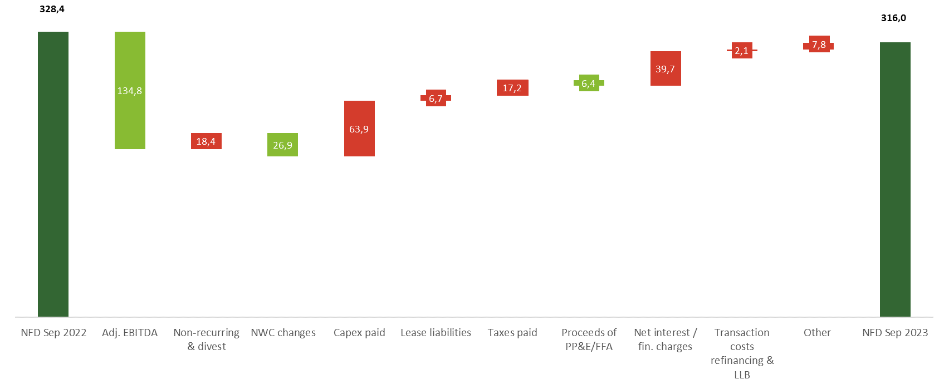
Net financial debt LTM – NFD excluding lease liabilities improves by € 12,3m thanks to increased operational result, partially offset by an inventory increase of € 44,0m, mainly due to inflation
Proceeds of Petrolina Brazil and UK
Impact of increased inventories of € 44,0m. AP/AR net impact of - € 68,2m.
Including share based payments € 0,6m, claim settlement for € 3,6m, gain on sale of assets € 1,6m (non UK and Petrolina) and purchase of Gigi
Divestitures of Fresh UK & France for € 11,2m and non-recurring costs of € 7,1m mainly H2 2223 related to restructuring in UK, FR and claims (Chiquita)
Notes:
NICOLAS:
NFD improves with € 12 million compared to the same period last year, thanks to the operational result and a positive working capital, even taken into account an increase of the inventories in Long Fresh due to inflation of € 44 millilon.
We invested € 64 million the last 12 months, of which € 27,9 million the last 6 months.
Divestiture of UK: € 2,9m
Divestiture of FR: € 8,3m
Gigi purchase: € 0,5m

Slide 14
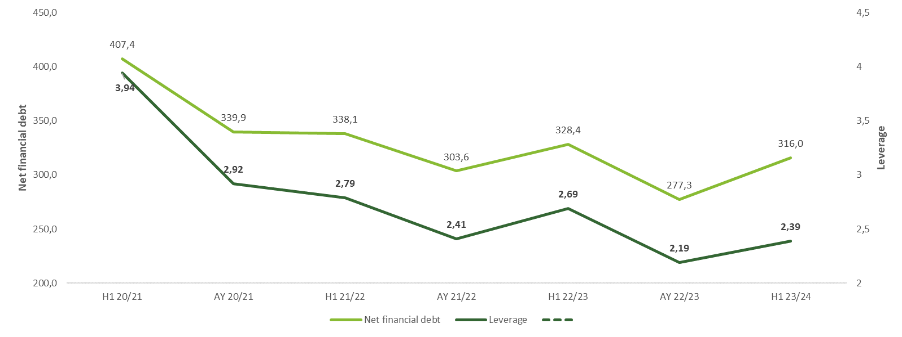
Leverage evolution (Pre-IFRS 16)* | Leverage decreased from 2,69x to 2,39x compared to the same period last year
  Pre-IFRS 16 forecast per September 2023:
  Net financial debt € 316,0m
  LTM Adj. EBITDA € 132,0m
  Leverage ratio (Pre-IFRS 16) 2,39x
Annual Jun-Nov inventory build-up in Long Fresh
In €m
  * Pre-IFRS 16 covenant, conform bank definition
Notes:
Nicolas
Pre-IFRS leverage at 2,4x, which is a strong decrease compared to the same period last year, and this within the normal seasonality in inventory build up, with clearly the impact of inflation on the value of the inventory.

Slide 15
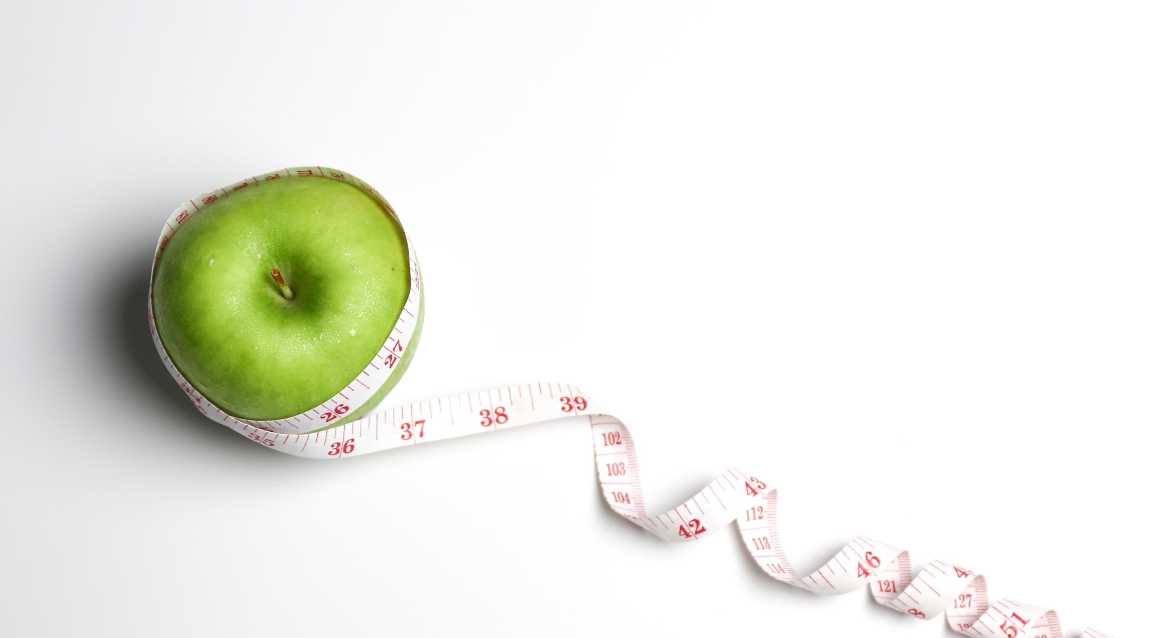
Capital Allocation and Leverage
CAPEX | H1: € 29,8m | Continue to invest in strategic operations driving growth
Leverage | H1: 2,4x | Maintain leverage in line with communicated 2,0x – 2,5x, even in high season
Dividend | € 0,10 | Commitment to return cash to shareholders in line with dividend policy
Notes:
Nicolas
In terms of capital allocation, we continue to invest in the company, with around 50% of growth CAPEX.
We keep leverage within the set bandwith (2,0x – 2,5x), even in the high season (which we are in now, with the value of the inventory inflated even more through higher raw material prices)
We committed to a first dividend of 10cts, returing cash again to the shareholders. No fixed dividend policy is devided yet;
We also confirm that we still believe that the market needs further consolidation. Greenyard is ready to take up the role of consolidator, with the clear message that it needs to be a partner that believes in the same business model or is complementary in the business model to integrate with the customer in their important markets.

Slide 16
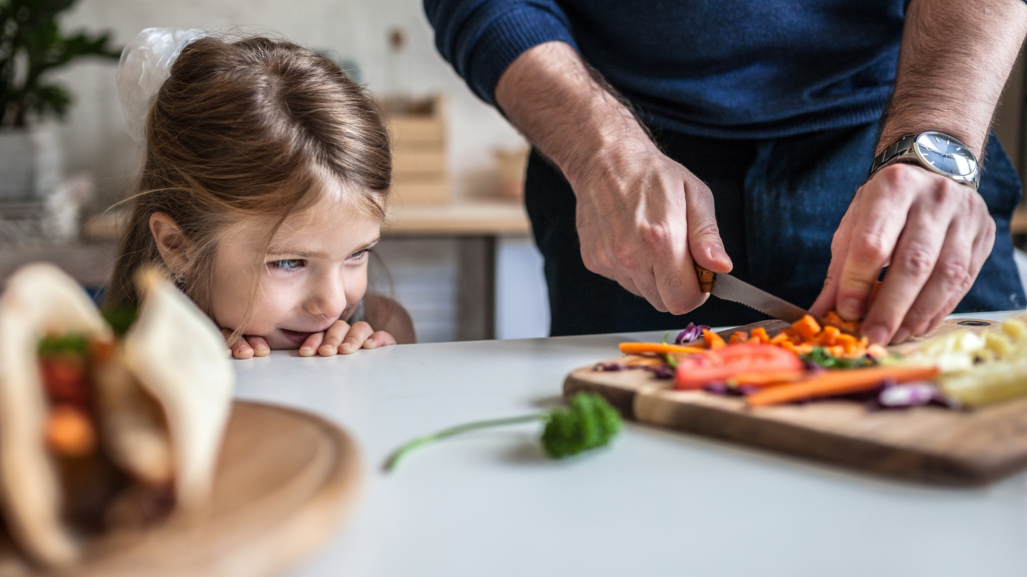
Outlook

Slide 17

Outlook
Net Sales: ~ € 4 900m
Adjusted EBITDA: between € 175 and 180m
Full year
2023-2024
Net Sales: ~ € 5 400m
Adjusted EBITDA: between € 200 and 210m
Ambition
2025-2026
Notes:
MARC:
We reconfirm our guidance and our ambitions.
For this year, we have informed that market that we believe that sales could grow to 4,9bn with an adjusted EBITDA between €175m and €180m.
Those numbers would grow to 5,4b, and 200 – 210m for the financial year ending March 2026.
We have multiple initiatives to work towards those ambitions and are confident to confirm.

Slide 18
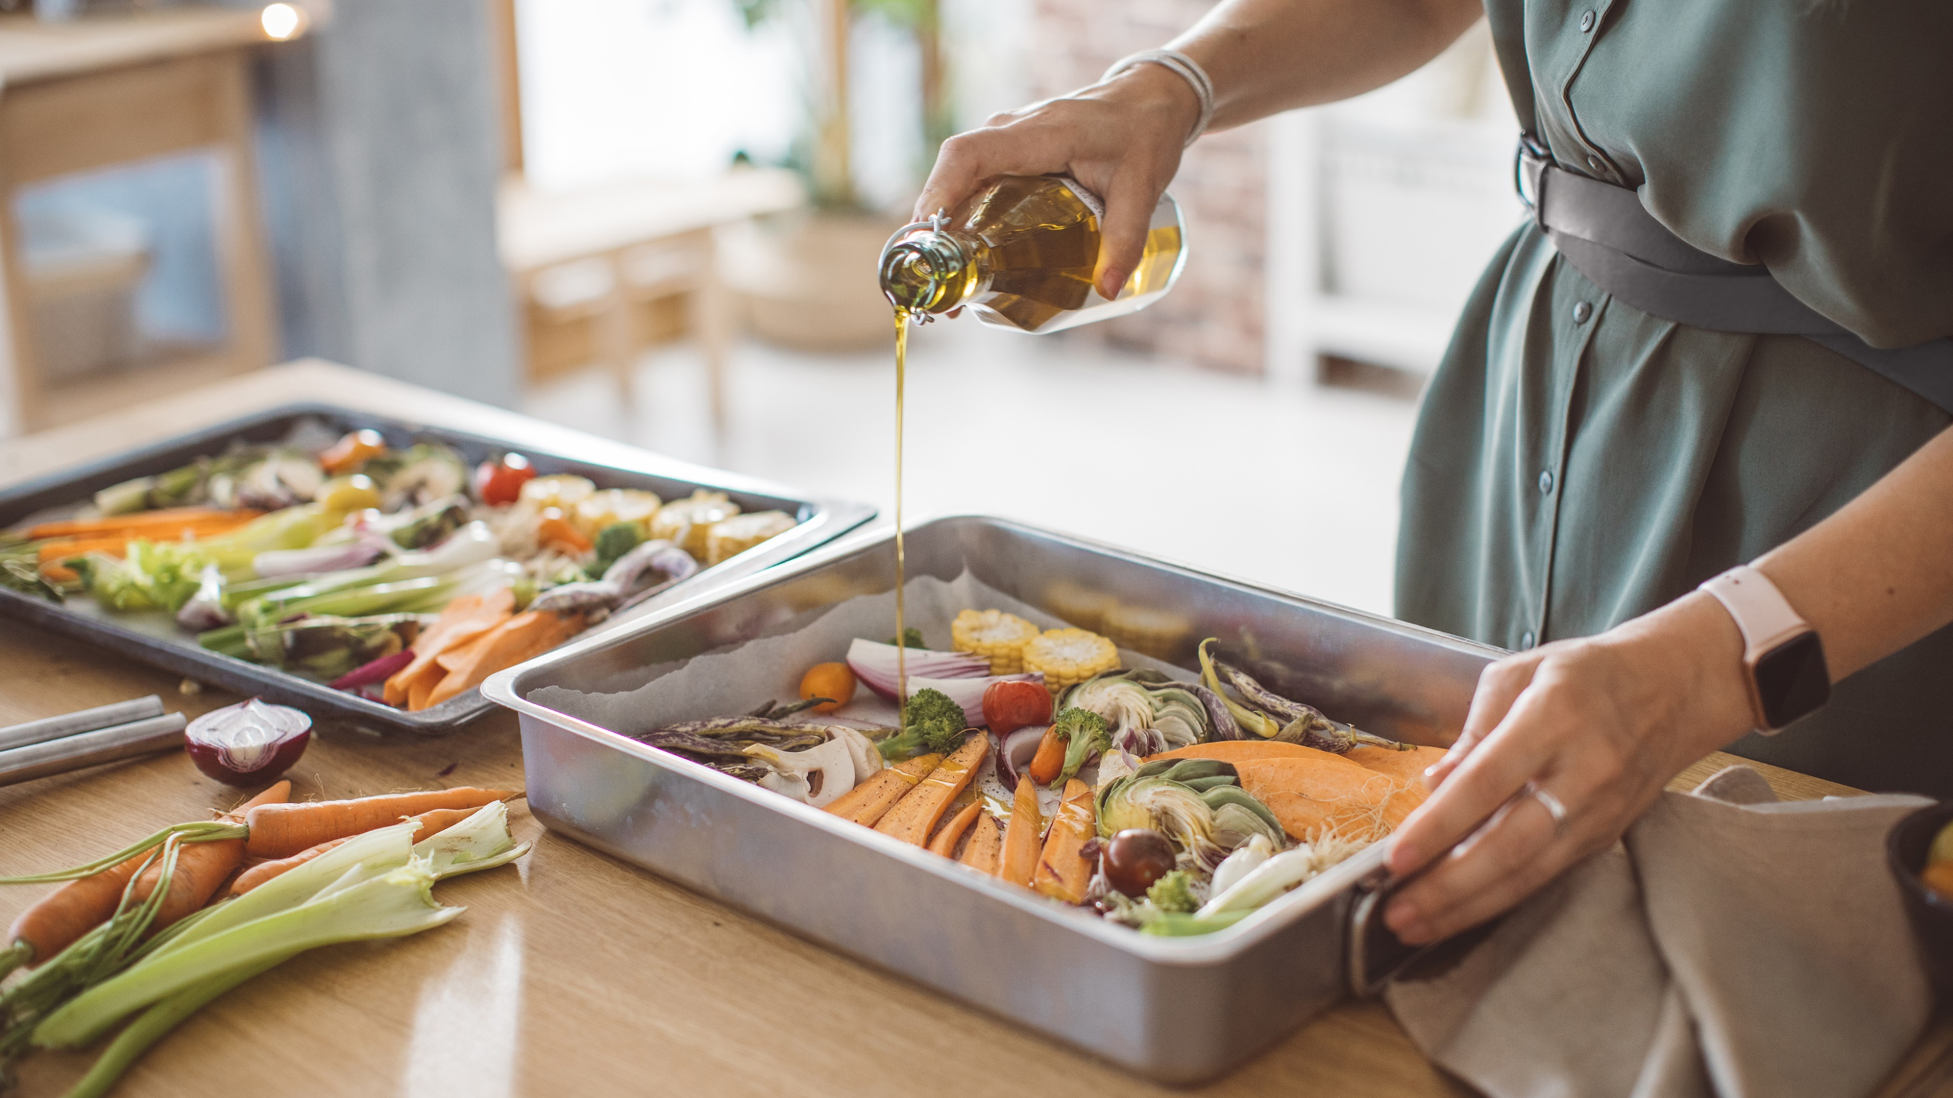
Q&A

